Slide 1
Developing and evaluating your Extract, Transform, Load (ETL) process to the OMOP Common Data Model
Gabriel Maeztu IOMED

Slide 2
What this tutorial will provide . . .
Suggested process for developing a CDM ETL
OHDSI ETL tools: White Rabbit, Rabbit-In-A-Hat
Resources like the Book of OHDSI and THEMIS
Generation of a simple ETL

Slide 3
Foundational Concepts

Slide 4
What is the OMOP Vocabulary?

Slide 5
OMOP Common Vocabulary Model reference data for the OMOP CDM
What it is
Compiled standards from disparate public and private sources and some OMOP-grown concepts
Standardized structure to house existing vocabularies used in the public domain
What it’s not
Static dataset – the vocabulary updates regularly to keep up with the continual evolution of the sources
Finished product – vocabulary maintenance and improvement is ongoing activity that requires community participation and support

Slide 6
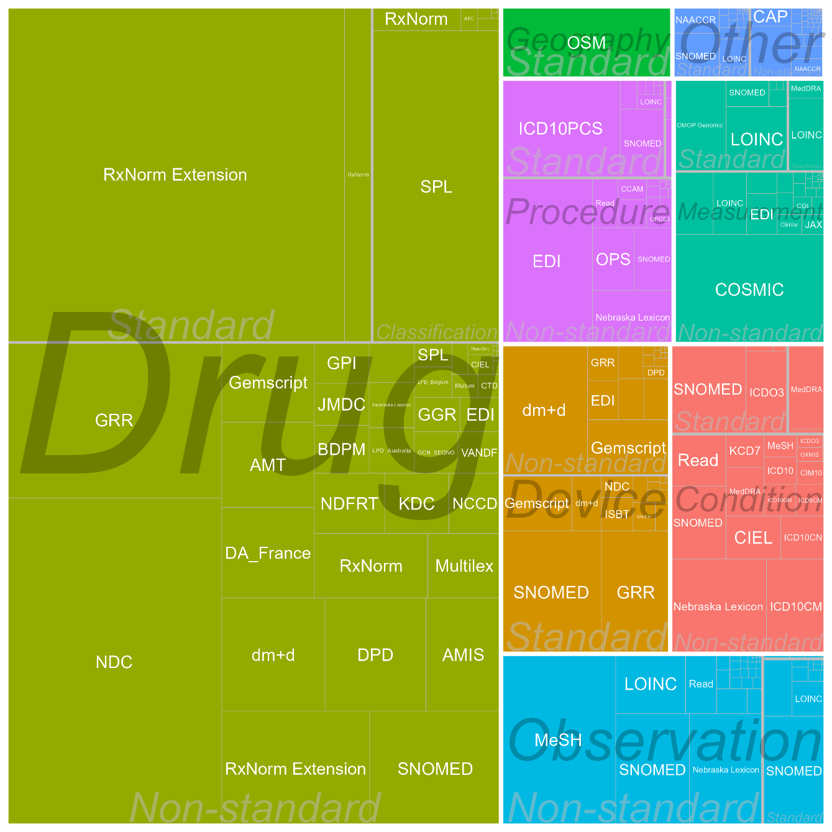
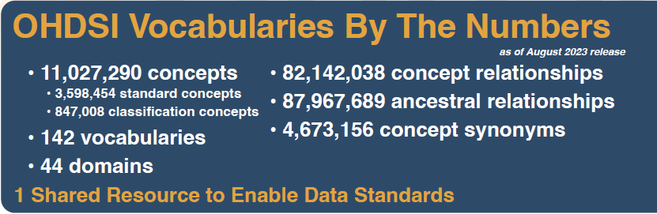
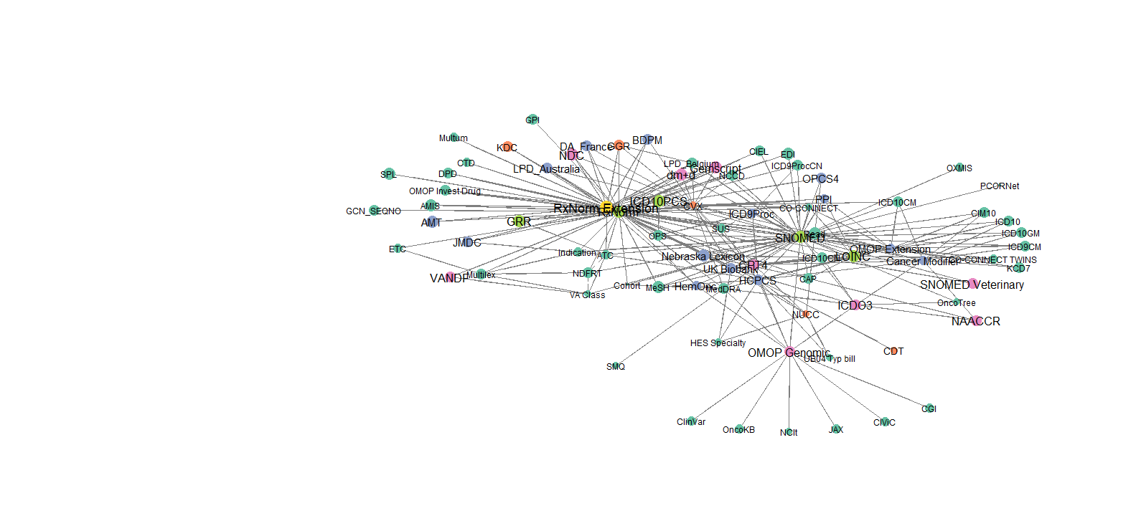
OHDSI Standard Vocabularies

Slide 7
What's in a Concept
For use in CDM
CONCEPT_ID | 313217
CONCEPT_NAME | Atrial fibrillation
DOMAIN_ID | Condition
VOCABULARY_ID | SNOMED
CONCEPT_CLASS_ID | Clinical Finding
STANDARD_CONCEPT | S
CONCEPT_CODE | 49436004
VALID_START_DATE | 01-Jan-1970
VALID_END_DATE | 31-Dec-2099
INVALID_REASON
English description
Domain
Vocabulary
Class in SNOMED
Concept in data
Code in SNOMED
Valid during time interval

Slide 8
Source Codes, Concepts and Mapping to Standard Concepts

Slide 9
The Source for Source Codes
May come from international terminology or code system
SNOMED
1
May come from a country specific terminology or code system
Read, BDPM, ICD10CN, CVX
2
May be free text strings
Centimeter, Intravenous, Cigarette Smoker
3
May come from an EHR specific code system
Epic procedure codes: ‘L111’
4

Slide 10
Different Categories of Concepts
Non- standard Concepts
Standard Concepts
Classification
Concepts
Function
Unique representation of a source code
Function
Used for standardized analytics and by
OHDSI tools
Function
Used to perform hierarchical queries

Slide 11
Mapping non-standard concept_ids to standard concept_ids
CONCEPT RELATIONSHIP
Non-standard Concepts
Standard Concepts

Slide 12
Mapping Source Codes to Standard Concept_IDs

Slide 13
Source Codes Mapping – Scenario 1
Scenario
Solution
Source code is available in an OHDSI supported Vocabulary
Use using the following condition to perform the mapping:
Where <source code> = CONCEPT.concept_code and <source vocabulary> = CONCEPT.vocabulary_id
Source code | Source vocabulary | Code description | CONCEPT.concept_id
61462000 | SNOMED | Malaria | 438067
A663D00 | Read | Zika Fever | 45489770

Slide 14
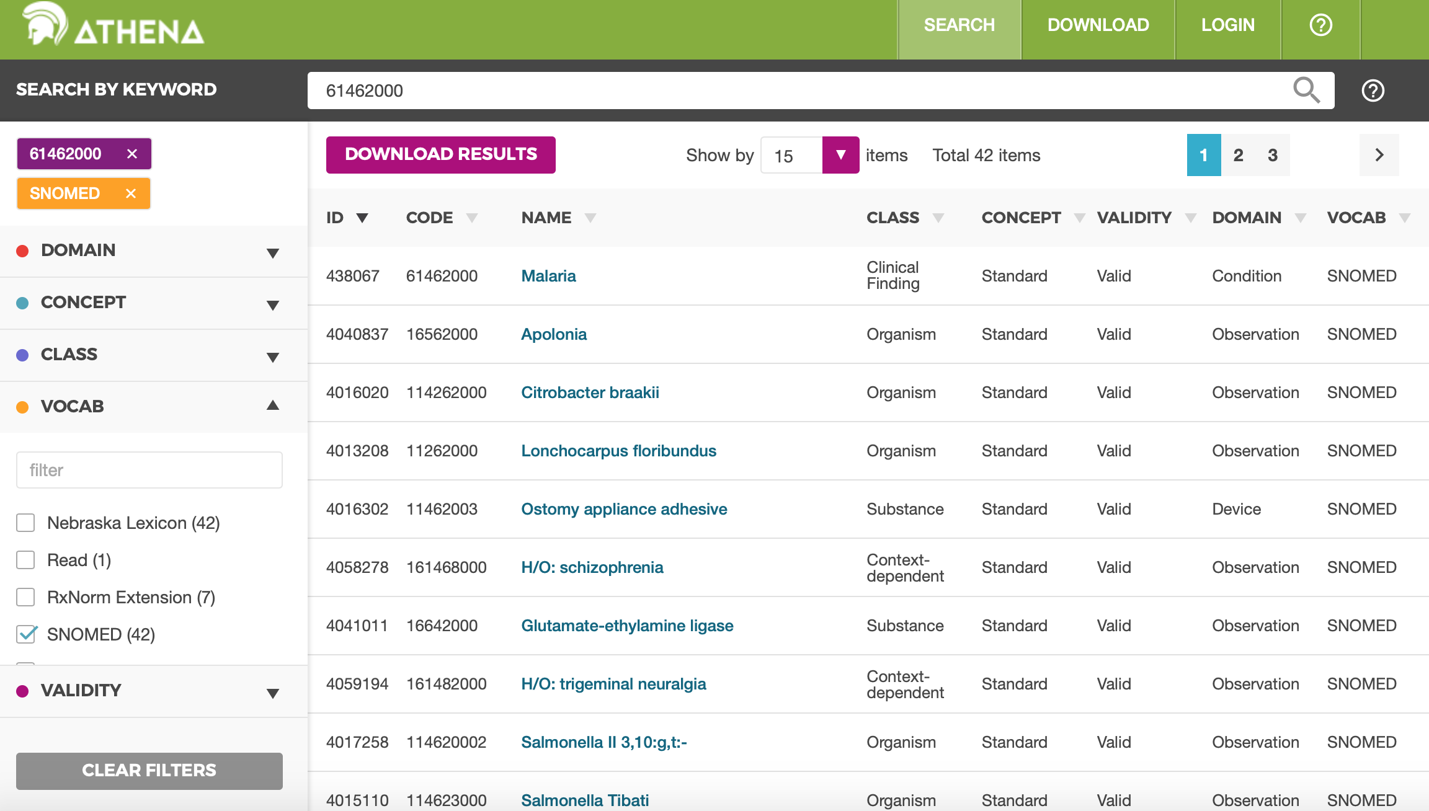

Slide 15
Source Codes Mapping – Scenario 2
Scenario
Solution
Source code is a text string
Use using the following condition to perform the mapping:
Where <source string> = CONCEPT.concept_name and <source domain> = CONCEPT.domain_id
Source string | Source domain | Source table/field | CONCEPT.concept_id
Centimeter | Unit | Unit for height measurement field | 8582
Intravenous | Route | Route for drug administration field | 4171047
EDD | Observation | Pregnancy data table | 3011536

Slide 16
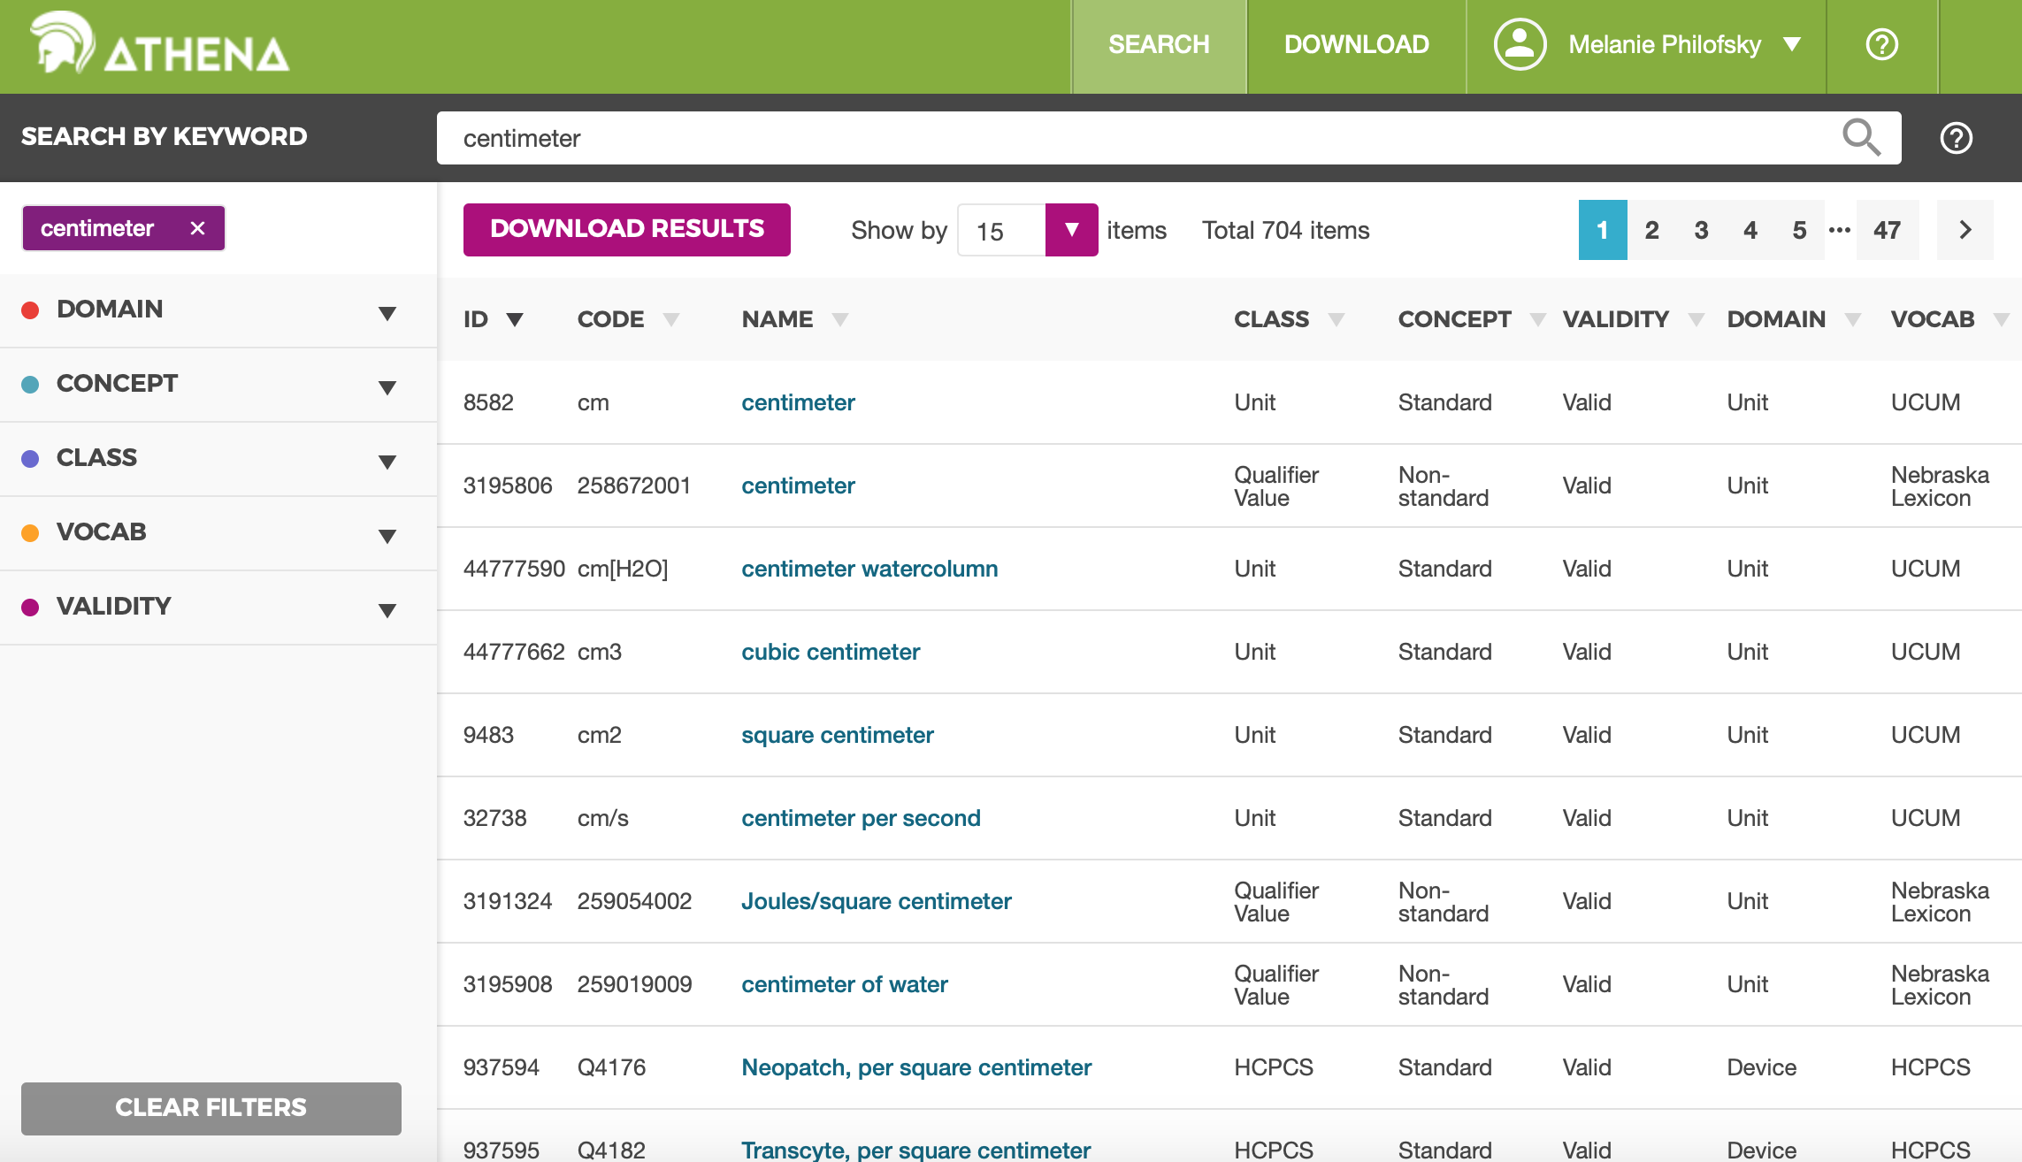

Slide 17
Source Codes Mapping – Scenario 3
Scenario
Solution
Source data does not map to standard vocabulary
Ask OHDSI to incorporate the vocabulary
Utilize the community contribution process

Slide 18
Other Relationships: Hierarchical and Part-of Relationships

Slide 19
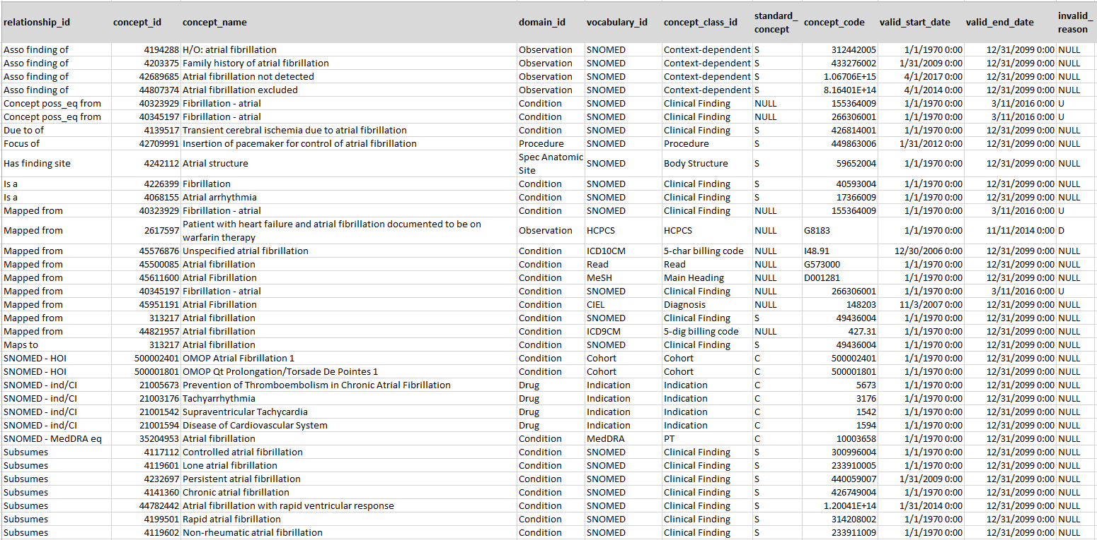
Exploring Relationships
SELECT cr.relationship_id, c.* FROM concept_relationship cr
JOIN concept c ON cr.concept_id_2 = c.concept_id
WHERE cr.concept_id_1 = 313217
Find out related concept
Ancestor concepts
Relationships are bi-directional: ‘Maps to’ and ‘Mapped from’; ‘Is a’ and ‘Subsumes’ etc.
Descendant concepts

Slide 20
Type of Relationships
‘Maps to’
‘Maps to Value’
All source vocabularies, provided by source or built by Vocab Team
Standard are mapped to themselves
Entity Relationships
‘Has direct procedure site’
‘Has method’
‘Occurs after’
Controlled well-structured ontologies: RxNorm, SNOMED, LOINC, ICD10PCS
Part-of Relationships
‘Is a’
‘Subsumes’
‘Panel Contains’
Standard and classificational terminologies (ATC, ETC, CVX, NDFRT)
Hierarchical Relationships

Slide 21
LOINC
Individual Tests
Panel
Has system
1029919 Blood
46235479 Bilirubin fractions panel [Moles/volume] - Serum or Plasma
3020491 Glucose [Moles/volume] in Blood
Has component
Panel contains
40795740 Glucose
3005772 Bilirubin.conjugated [Moles/volume] in Serum or Plasma
Has property
1029726 Substance Concentration
3043995 Bilirubin.conjugated +indirect [Moles/volume] in Serum or Plasma
Contained in panel
36304453 German Interdisciplinary Association of Intensive Care and Emergency Care Medicine - recommended MIND protocol set
3007242 Bilirubin.indirect [Moles/volume] in Serum or Plasma

Slide 22
OMOP CDM

Slide 23
OMOP CDM Principles
Patient centric
Vocabulary and Data Model are standardized
Domain-oriented concepts
Accommodates data from various sources
Preserves data provenance & source data
Extendable & Evolving
Database Platform Independent

Slide 24
CDM Version 5.4 Key Domains
Person
Standardized health system data
Standardized metadata
Observation_period
CDM_source
Location
Visit_occurrence
Metadata
Location_history
Visit_detail
Care_site
Standardized vocabularies
Condition_occurrence
Provider
Drug_exposure
Standardized derived elements
Concept
Procedure_occurrence
Vocabulary
Device_exposure
Condition_era
Standardized clinical data
Domain
Drug_era
Measurement
Concept_class
Dose_era
Note
Results Schema
Concept_relationship
Note_NLP
Cohort
Relationship
Survey_conduct
Cohort_definition
Concept_synonym
Observation
Standardized health economics
Concept_ancestor
Specimen
Cost
Source_to_concept_map
Fact_relationship
Payer_plan_period
Drug_strength

Slide 25
Two OMOP designs that might be confusing
OMOP tables combine data from multiple source tables
Ordered drugs, procedure drugs, vaccines are all in Drug Exposure
Duplicates removed
Source data may be distributed over multiple OMOP tables
Not all ICD10CM billing codes are in OMOP Condition Occurrence

Slide 26

W56.21XA
Bitten by orca, initial encounter
Notes:
they are about 8.5 feet long and 265 to 353 lbs. at birth. Orcas can hold their breath for up to 15 minutes

Slide 27
General CDM rules & requirements *found on CDM GitHub site
All clinical event_start_dates must be populated
Start dates must be <= death_date
End dates must be <= death_date + 60 days
If the end_date is populated, all event_start_dates must be <= event_end_dates
All clinical event_start_dates must be >= Birthdate

Slide 28
Themis: What is it?
The goal of Themis is to provide conventions on how source data should be standardized to the OMOP CDM to support the OHDSI community to generate the evidence that promotes better health decisions and better care. When there is ambiguity on how data should be inserted into the CDM, Themis will examine the issue, create a convention and document it.
We follow the FAIR principles: Findable, Accessible, Interoperable and Reusable.
Themis makes decisions for the good of the whole community. We must compromise. We can always revisit and modify the convention. Don’t let perfect be the enemy of great. And interoperability between different OMOP CDMs is great!

Slide 29
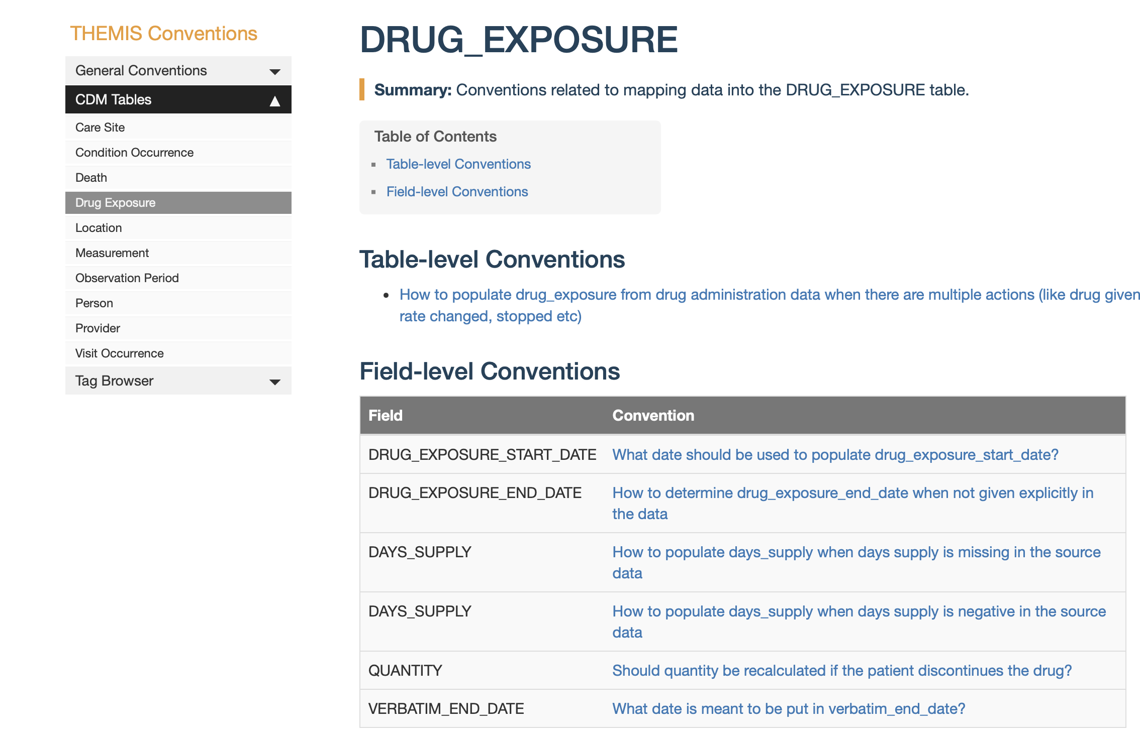
Themis convention library

Slide 30
CDM Version Control
Working group meets twice a month to discuss proposed changes to the CDM
All CDM documentation, versions, and proposals located on GitHub
https://ohdsi.github.io/CommonDataModel/index.html
Proposals tracked and discussed as GitHub issues
https://ohdsi.github.io/TheBookOfOhdsi/CommonDataModel.html
Meeting information can be found on the working group wiki page
Please contact Clair Blacketer (mblacke@its.jnj.com) for more information

Slide 31
THEMIS
What do I do when there’s ambiguity on how/where I should insert data into the OMOP CDM?
Themis WG meets twice a month on the 1st & 3rd Thursday of the month
Themis convention library houses all conventions
https://ohdsi.github.io/Themis/index.html
Themis GitHub contains issues, project plan and Themis process
https://github.com/OHDSI/Themis
Please contact Melanie Philofsky (Philofsky@ohdsi.org) for more information

Slide 32
Other Work Groups
Vocabulary
Health Systems
Download vocabulary tables from Athena
https://athena.ohdsi.org/search-terms/terms
Submit concerns on the Github
https://github.com/OHDSI/Vocabulary-v5.0
Support health systems on their OHDSI journey
Meet every other Monday at 10am Eastern Time on MS Teams
Healthcare Systems Interest Group | General | Microsoft Teams

Slide 33
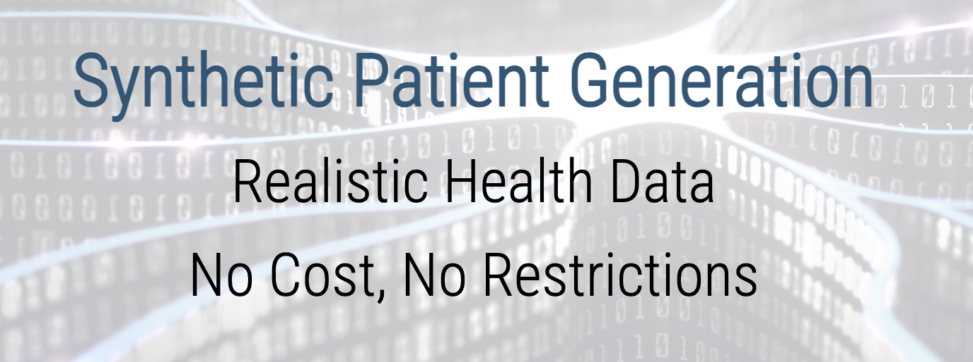

SyntheaTM Synthetic Patient Generator

Slide 34
What is Synthea?
SyntheaTM is a Synthetic Patient Population Simulator. The goal is to output synthetic, realistic (but not real), patient data and associated health records in a variety of formats.
The resulting data is free from cost, privacy, and security restrictions. It can be used without restriction for a variety of secondary uses in academia, research, industry, and government (although a citation would be appreciated).
https://github.com/synthetichealth/synthea
Walonoski J, Kramer M, Nichols J, Quina A, Moesel C, Hall D, Duffett C, Dube K, Gallagher T, McLachlan S. Synthea: An approach, method, and software mechanism for generating synthetic patients and the synthetic electronic health care record. J Am Med Inform Assoc. 2017 Aug 30. doi: 10.1093/jamia/ocx079. [Epub ahead of print] PubMed PMID: 29025144.

Slide 35
Synthea “Under the hood”
Synthea’s Generic Module Framework (GMF) enables modeling of various diseases and conditions that contribute to the medical history of synthetic patients.
Each Patient simulated independently from birth to present day
Modules define diseases, conditions and medical care
Original Modules based on
Top 10 reasons patients see PCP
Top 10 conditions that result in years of life lost
Additional modules available: Breast Cancer, COVID19, Veterans, UTI
https://github.com/synthetichealth/synthea/tree/gh-pages/graphviz

Slide 36
Synthea Tables
File | Description
allergies.csv | Patient allergy data.
careplans.csv | Patient care plan data, including goals.
claims.csv | Patient claim data.
claims_transactions.csv | Transactions per line item per claim
conditions.csv | Patient conditions or diagnoses.
devices.csv | Patient-affixed permanent and semi-permanent devices.
encounters.csv | Patient encounter data.
imaging_studies.csv | Patient imaging metadata.
immunizations.csv | Patient immunization data.
medications.csv | Patient medication data.
observations.csv | Patient observations including vital signs and lab reports.
organizations.csv | Provider organizations including hospitals.
patients.csv | Patient demographic data.
payer_transitions.csv | Payer Transition data (i.e. changes in health insurance).
payers.csv | Payer organization data.
procedures.csv | Patient procedure data including surgeries.
providers.csv | Clinicians that provide patient care.
supplies.csv | Supplies used in the provision of care.

Slide 37
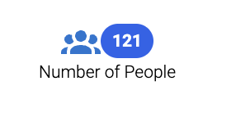
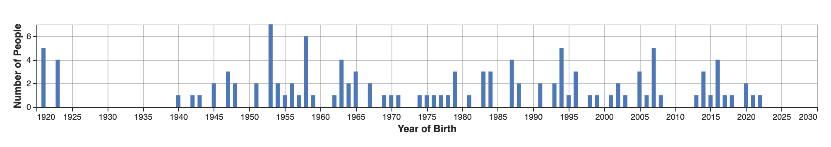
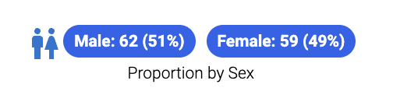

Our population
Year of Birth
Top 10 Conditions
Gingivitis | Anemia
Viral sinusitis | Impaired glucose tolerance
Acute Bronchitis | Essential Hypertension
Acute Viral Pharyngitis | Chronic Pain
Dental caries | Fracture of Bone

Slide 38
ETL Process and Logic

Slide 39









ETL Process
ETL Documentation
ETL
Data experts and CDM experts together design the ETL
People with medical knowledge create the code mappings
All are involved in quality control
A technical person implements the ETL
OHDSI Tools
White
Rabbit
Rabbit In a Hat
Usagi
White
Rabbit
ACHILLES
DQD
Rabbit In a Hat

Slide 40
ETL Process
ETL Documentation
ETL
Data experts and CDM experts together design the ETL
People with medical knowledge create the code mappings
We won’t be covering this today
All are involved in quality control
A technical person implements the ETL
X
OHDSI Tools
White
Rabbit
Rabbit In a Hat
Usagi
White
Rabbit
ACHILLES
DQD
Rabbit In a Hat

Slide 41

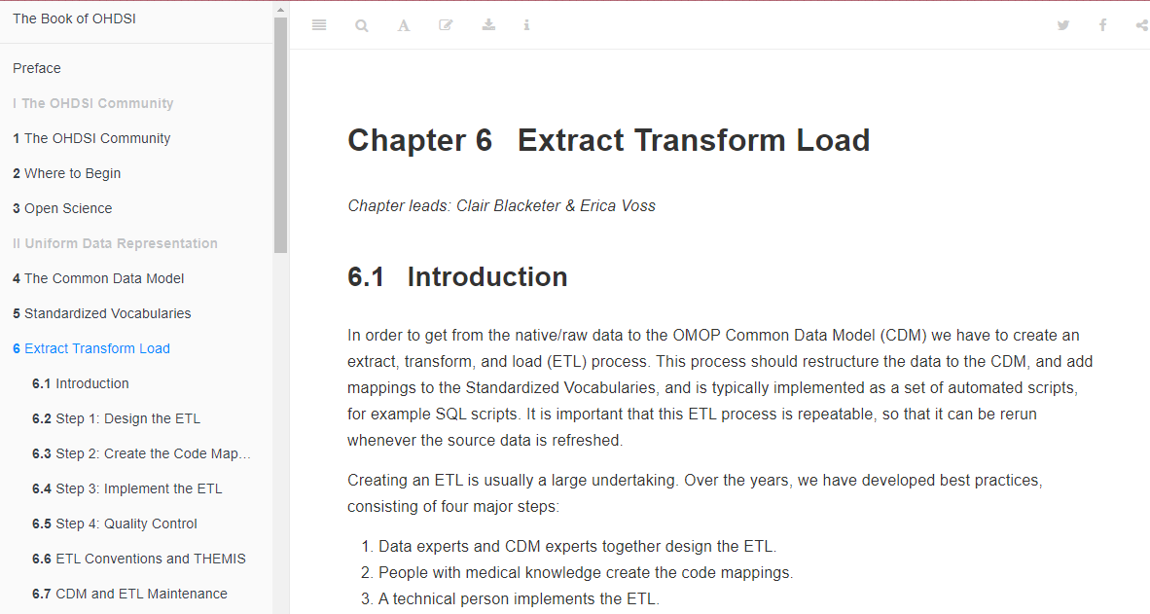
ETL Process
https://ohdsi.github.io/TheBookOfOhdsi/ExtractTransformLoad.html

Slide 42
Follow-Along Exercises for Today
Scan a database with White Rabbit
Practice building an ETL document with Rabbit in a Hat
Examining Achilles and Data Quality Dashboard output

Slide 43
Tools help us get started . . .
White Rabbit
Rabbit In a Hat
performs a scan of the source data, providing detailed information on the tables, fields, and values that appear in a field
Uses White Rabbit scan to provide a graphical user interface to help build an ETL document
Does not generate code

Slide 44
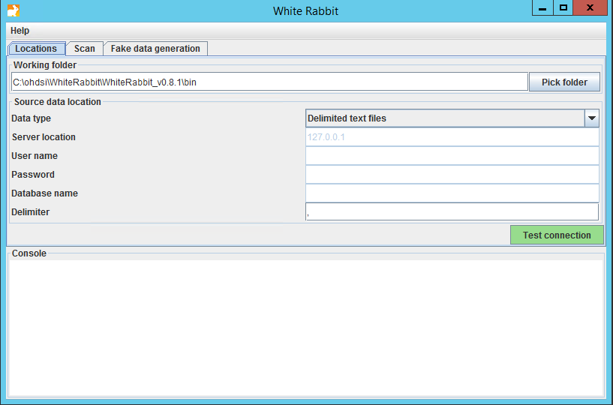
White Rabbit - Location

Slide 45
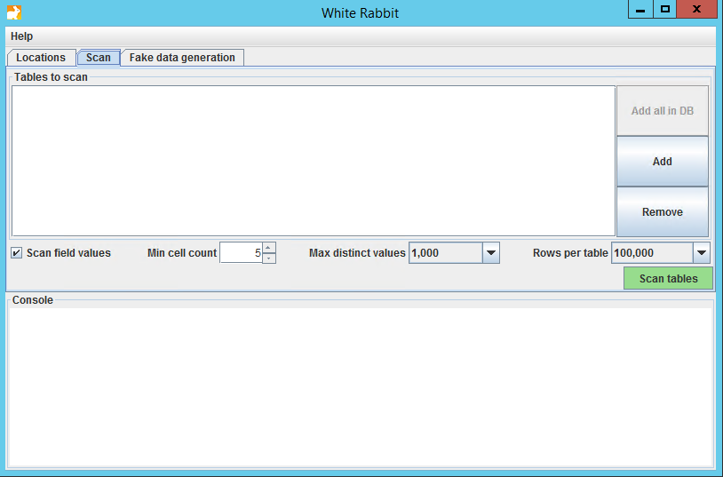
White Rabbit - Scan

Slide 46
White Rabbit - Scan

Slide 47
White Rabbit - Scan

Slide 48
White Rabbit – Scan Report
synthea
We already ran the scan on synthea native data
To open the scan while we review:
https://github.com/OHDSI/Tutorial-ETL
Materials 🡪 WhiteRabbit 🡪 Synthea_ScanReport.xlsx
Click “View Raw” to download the XLSX

Slide 49
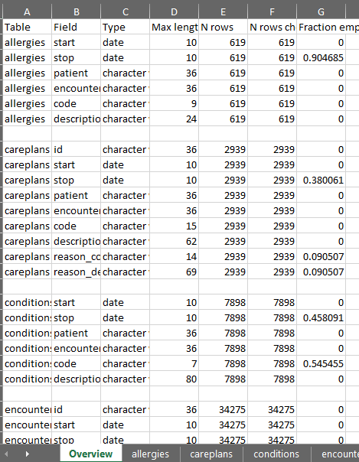
White Rabbit – Scan Report: Synthea
Overview Tab

Slide 50
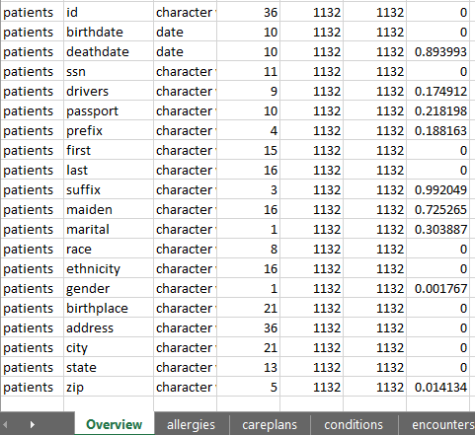
White Rabbit – Scan Report: Synthea
Overview Tab

Slide 51
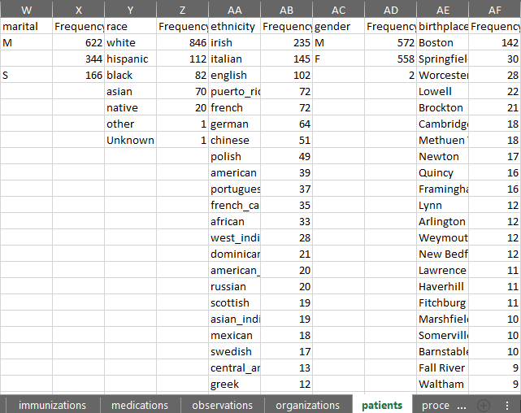
White Rabbit – Scan Report: Synthea
Patients Tab
Notes:
Ethnicity = (Hispanics and Non-Hispanics)
Race = (white, black, Asian, native, other, unknown)

Slide 52
Review Scan Report
Look for
Odd values in dates
Missing genders
Missing birth years or birthdates
Missing codes

Slide 53
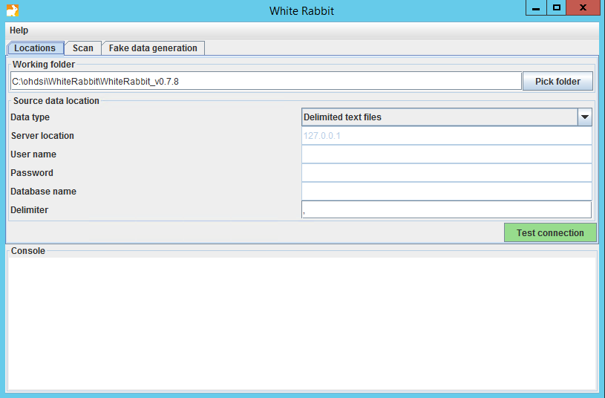
White Rabbit
White Rabbit creates an export of information about the source data
The scan can be used to:
Learn about your source data
Used by Rabbit In a Hat

Slide 54
Rabbit in a Hat
Can read and display a White Rabbit scan document
Provides a graphical interface to allow a user to connect source data to tables

Slide 55

Rabbit in a Hat
Synthea
We will use the Synthea_ScanReport.xlsx for this:
https://github.com/OHDSI/Tutorial-ETL
Materials 🡪 WhiteRabbit 🡪 Synthea_ScanReport.xlsx
Press the “Download” button
Save it to the desktop
Open it Rabbit in a Hat

Slide 56
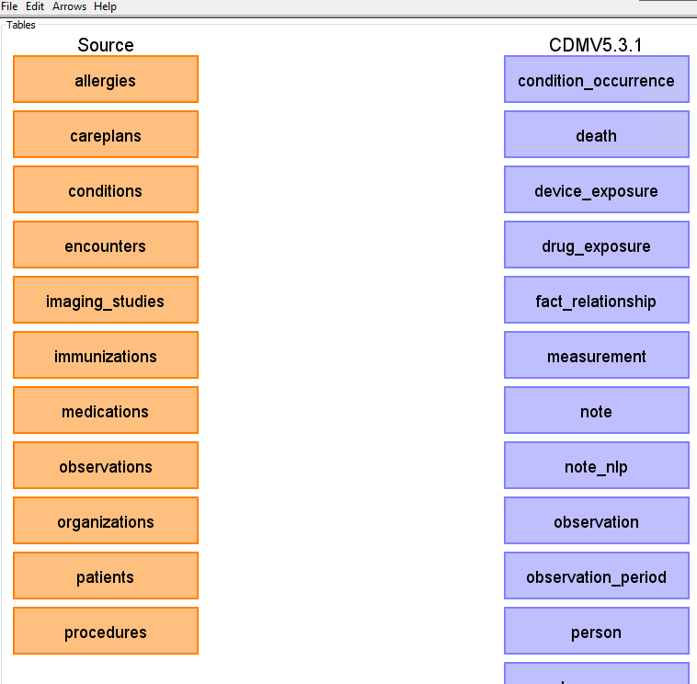
Rabbit in a Hat
The scan tells Rabbit in a Hat what is in the raw database
Orange Tables = Raw
Blue Tables = CDM

Slide 57

Rabbit in a Hat
Tables we will go through today ->
Person
Generate document
Observation_period
Visit_occurrence
Condition_occurrence
Drug_exposure
Notes:
In the condition occurrence table – we can come back to this and augment with source code mapping
Should think about how to find TYPE concepts

Slide 58

Resources
Important links to keep in mind when working on an ETL:
CDM Documentation https://ohdsi.github.io/CommonDataModel Information about the CDM structure and conventions to follow can be found here
OHDSI Forums http://forums.ohdsi.org/ http://forums.ohdsi.org/c/cdm-builders OHDSI is an active community, your questions may have already been asked on the forum however if not do not be afraid to ask it yourself!
Book of OHDSI: ETL Chapter https://ohdsi.github.io/TheBookOfOhdsi/ExtractTransformLoad.html The OHSDI community wrote the book to serve as a central knowledge repository for all things OHDSI.
THEMIS Repository https://ohdsi.github.io/Themis/

Slide 59
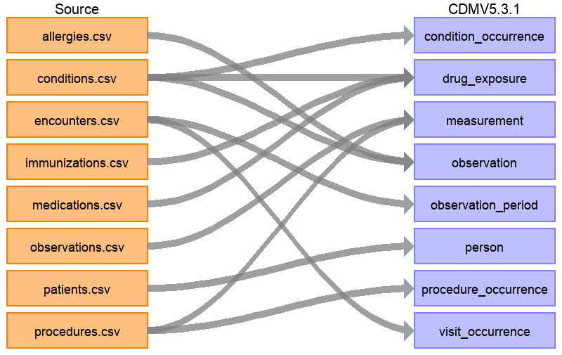
Rabbit in a Hat
The full ETL document: https://ohdsi.github.io/ETL-Synthea/
Notes:
Pull up drug exposure

Slide 60
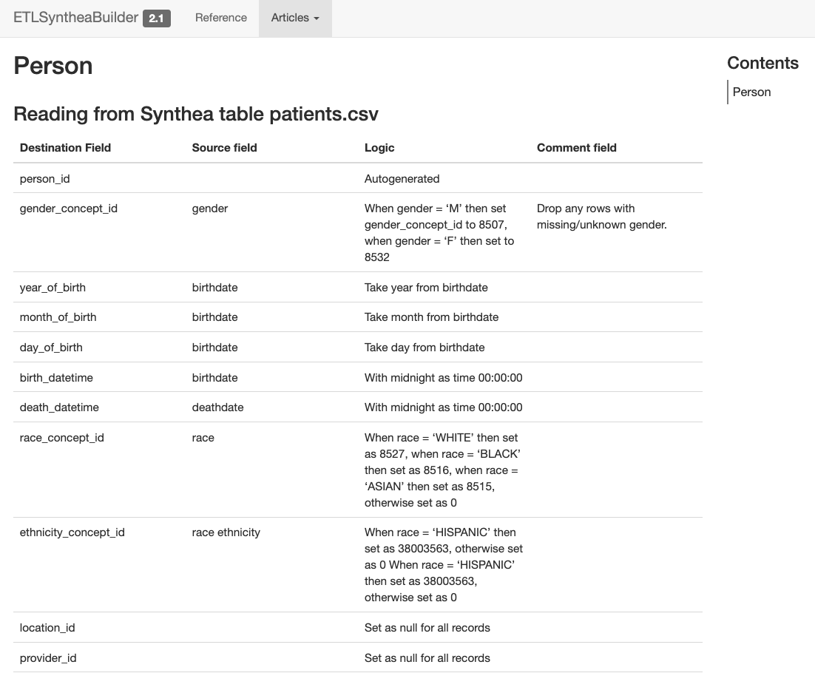
PERSON
https://ohdsi.github.io/ETL-Synthea/articles/person.html

Slide 61
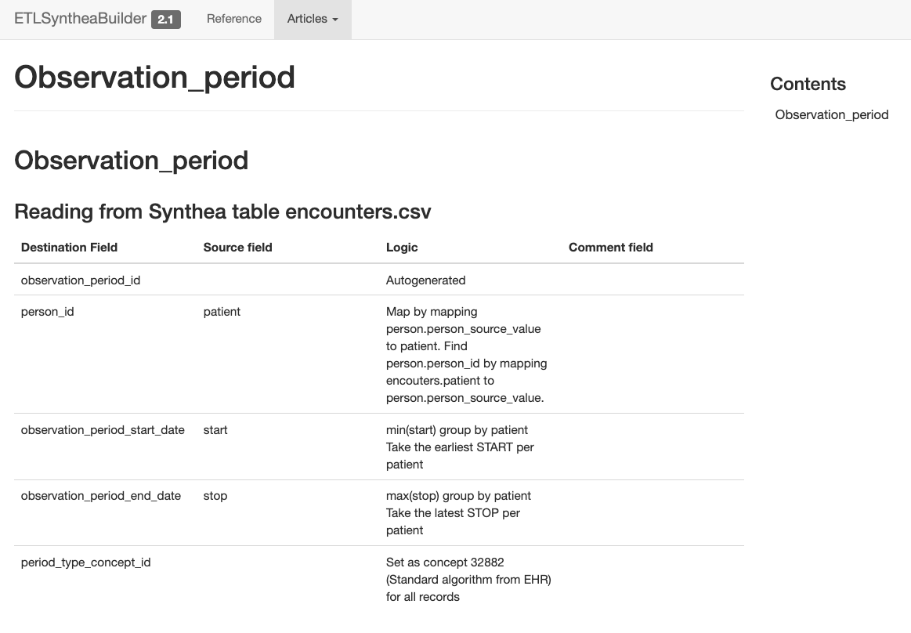
OBSERVATION_PERIOD
https://ohdsi.github.io/ETL-Synthea/articles/observation_period.html

Slide 62
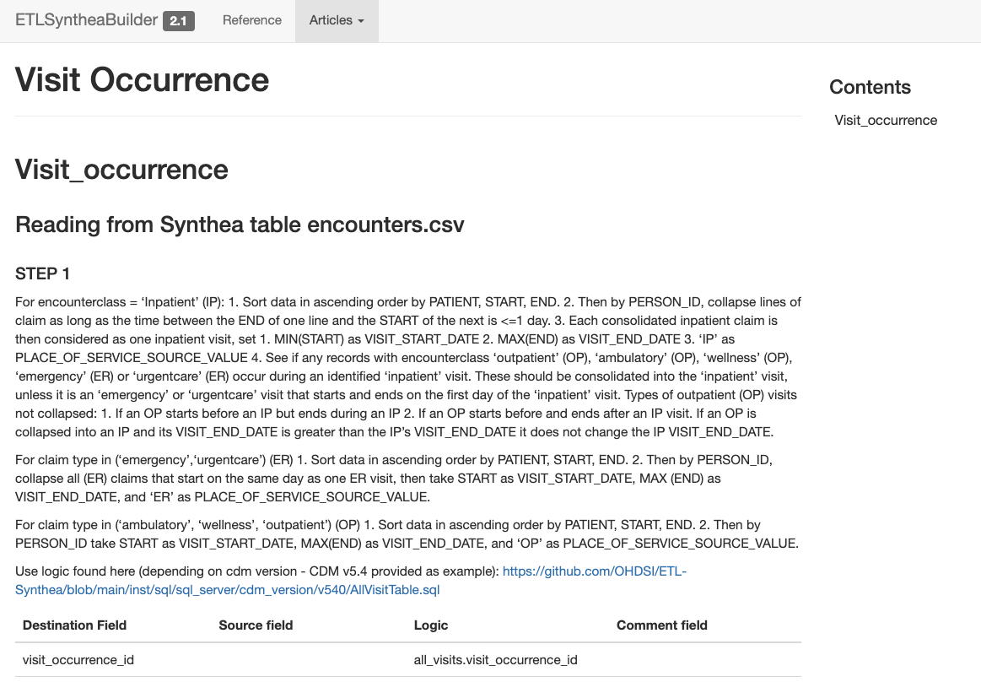
VISIT_OCCURRENCE
ETL Conventions: https://ohdsi.github.io/CommonDataModel/cdm54.html#visit_occurrence
Visit Hierarchy
IP
>
ER
>
OP

Slide 63
OMOP Vocab
There are two standard queries to help us use the OMOP Vocabulary:
SOURCE_TO_STANDARD.sql
SOURCE_TO_SOURCE.sql
https://github.com/OHDSI/Tutorial-ETL
Materials 🡪 Queries

Slide 64
Source to Standard
WITH CTE_VOCAB_MAP AS (
SELECT c.concept_code AS SOURCE_CODE, c.concept_id AS SOURCE_CONCEPT_ID, c.concept_name AS SOURCE_CODE_DESCRIPTION,
c.vocabulary_id AS SOURCE_VOCABULARY_ID, c.domain_id AS SOURCE_DOMAIN_ID, c.CONCEPT_CLASS_ID AS SOURCE_CONCEPT_CLASS_ID,
c.VALID_START_DATE AS SOURCE_VALID_START_DATE, c.VALID_END_DATE AS SOURCE_VALID_END_DATE, c.INVALID_REASON AS SOURCE_INVALID_REASON, c1.concept_id AS TARGET_CONCEPT_ID, c1.concept_name AS TARGET_CONCEPT_NAME, c1.VOCABULARY_ID AS TARGET_VOCABUALRY_ID,
c1.domain_id AS TARGET_DOMAIN_ID, c1.concept_class_id AS TARGET_CONCEPT_CLASS_ID, c1.INVALID_REASON AS TARGET_INVALID_REASON, c1.standard_concept AS TARGET_STANDARD_CONCEPT
FROM CONCEPT C
JOIN CONCEPT_RELATIONSHIP CR
ON C.CONCEPT_ID = CR.CONCEPT_ID_1
AND CR.invalid_reason IS NULL
AND cr.relationship_id = 'Maps to'
JOIN CONCEPT C1
ON CR.CONCEPT_ID_2 = C1.CONCEPT_ID
AND C1.INVALID_REASON IS NULL
UNION
SELECT source_code, SOURCE_CONCEPT_ID, SOURCE_CODE_DESCRIPTION, source_vocabulary_id, c1.domain_id AS SOURCE_DOMAIN_ID, c2.CONCEPT_CLASS_ID AS SOURCE_CONCEPT_CLASS_ID,c1.VALID_START_DATE AS SOURCE_VALID_START_DATE,
c1.VALID_END_DATE AS SOURCE_VALID_END_DATE, stcm.INVALID_REASON AS SOURCE_INVALID_REASON,target_concept_id,
c2.CONCEPT_NAME AS TARGET_CONCEPT_NAME, target_vocabulary_id, c2.domain_id AS TARGET_DOMAIN_ID,
c2.concept_class_id AS TARGET_CONCEPT_CLASS_ID, c2.INVALID_REASON AS TARGET_INVALID_REASON,
c2.standard_concept AS TARGET_STANDARD_CONCEPT
FROM source_to_concept_map stcm
LEFT OUTER JOIN CONCEPT c1
ON c1.concept_id = stcm.source_concept_id
LEFT OUTER JOIN CONCEPT c2
ON c2.CONCEPT_ID = stcm.target_concept_id
WHERE stcm.INVALID_REASON IS NULL
)
SELECT TARGET_CONCEPT_ID, TARGET_CONCEPT_NAME, TARGET_DOMAIN_ID
FROM CTE_VOCAB_MAP
WHERE SOURCE_CODE = 'N94.6'
AND SOURCE_VOCABULARY_ID = 'ICD10CM'
AND TARGET_STANDARD_CONCEPT = 'S'

Slide 65
Source to Standard
WITH CTE_VOCAB_MAP AS (
SELECT c.concept_code AS SOURCE_CODE, c.concept_id AS SOURCE_CONCEPT_ID, c.concept_name AS SOURCE_CODE_DESCRIPTION,
c.vocabulary_id AS SOURCE_VOCABULARY_ID, c.domain_id AS SOURCE_DOMAIN_ID, c.CONCEPT_CLASS_ID AS SOURCE_CONCEPT_CLASS_ID,
c.VALID_START_DATE AS SOURCE_VALID_START_DATE, c.VALID_END_DATE AS SOURCE_VALID_END_DATE, c.INVALID_REASON AS SOURCE_INVALID_REASON, c1.concept_id AS TARGET_CONCEPT_ID, c1.concept_name AS TARGET_CONCEPT_NAME, c1.VOCABULARY_ID AS TARGET_VOCABUALRY_ID,
c1.domain_id AS TARGET_DOMAIN_ID, c1.concept_class_id AS TARGET_CONCEPT_CLASS_ID, c1.INVALID_REASON AS TARGET_INVALID_REASON, c1.standard_concept AS TARGET_STANDARD_CONCEPT
FROM CONCEPT C
JOIN CONCEPT_RELATIONSHIP CR
ON C.CONCEPT_ID = CR.CONCEPT_ID_1
AND CR.invalid_reason IS NULL
AND cr.relationship_id = 'Maps to'
JOIN CONCEPT C1
ON CR.CONCEPT_ID_2 = C1.CONCEPT_ID
AND C1.INVALID_REASON IS NULL
UNION
SELECT source_code, SOURCE_CONCEPT_ID, SOURCE_CODE_DESCRIPTION, source_vocabulary_id, c1.domain_id AS SOURCE_DOMAIN_ID, c2.CONCEPT_CLASS_ID AS SOURCE_CONCEPT_CLASS_ID,c1.VALID_START_DATE AS SOURCE_VALID_START_DATE,
c1.VALID_END_DATE AS SOURCE_VALID_END_DATE, stcm.INVALID_REASON AS SOURCE_INVALID_REASON,target_concept_id,
c2.CONCEPT_NAME AS TARGET_CONCEPT_NAME, target_vocabulary_id, c2.domain_id AS TARGET_DOMAIN_ID,
c2.concept_class_id AS TARGET_CONCEPT_CLASS_ID, c2.INVALID_REASON AS TARGET_INVALID_REASON,
c2.standard_concept AS TARGET_STANDARD_CONCEPT
FROM source_to_concept_map stcm
LEFT OUTER JOIN CONCEPT c1
ON c1.concept_id = stcm.source_concept_id
LEFT OUTER JOIN CONCEPT c2
ON c2.CONCEPT_ID = stcm.target_concept_id
WHERE stcm.INVALID_REASON IS NULL
)
SELECT TARGET_CONCEPT_ID, TARGET_CONCEPT_NAME, TARGET_DOMAIN_ID
FROM CTE_VOCAB_MAP
WHERE SOURCE_CODE = 'N94.6'
AND SOURCE_VOCABULARY_ID = 'ICD10CM'
AND TARGET_STANDARD_CONCEPT = 'S'
Look in the OMOP Vocabulary for a map

Slide 66
Source to Standard
WITH CTE_VOCAB_MAP AS (
SELECT c.concept_code AS SOURCE_CODE, c.concept_id AS SOURCE_CONCEPT_ID, c.concept_name AS SOURCE_CODE_DESCRIPTION,
c.vocabulary_id AS SOURCE_VOCABULARY_ID, c.domain_id AS SOURCE_DOMAIN_ID, c.CONCEPT_CLASS_ID AS SOURCE_CONCEPT_CLASS_ID,
c.VALID_START_DATE AS SOURCE_VALID_START_DATE, c.VALID_END_DATE AS SOURCE_VALID_END_DATE, c.INVALID_REASON AS SOURCE_INVALID_REASON, c1.concept_id AS TARGET_CONCEPT_ID, c1.concept_name AS TARGET_CONCEPT_NAME, c1.VOCABULARY_ID AS TARGET_VOCABUALRY_ID,
c1.domain_id AS TARGET_DOMAIN_ID, c1.concept_class_id AS TARGET_CONCEPT_CLASS_ID, c1.INVALID_REASON AS TARGET_INVALID_REASON, c1.standard_concept AS TARGET_STANDARD_CONCEPT
FROM CONCEPT C
JOIN CONCEPT_RELATIONSHIP CR
ON C.CONCEPT_ID = CR.CONCEPT_ID_1
AND CR.invalid_reason IS NULL
AND cr.relationship_id = 'Maps to'
JOIN CONCEPT C1
ON CR.CONCEPT_ID_2 = C1.CONCEPT_ID
AND C1.INVALID_REASON IS NULL
UNION
SELECT source_code, SOURCE_CONCEPT_ID, SOURCE_CODE_DESCRIPTION, source_vocabulary_id, c1.domain_id AS SOURCE_DOMAIN_ID, c2.CONCEPT_CLASS_ID AS SOURCE_CONCEPT_CLASS_ID,c1.VALID_START_DATE AS SOURCE_VALID_START_DATE,
c1.VALID_END_DATE AS SOURCE_VALID_END_DATE, stcm.INVALID_REASON AS SOURCE_INVALID_REASON,target_concept_id,
c2.CONCEPT_NAME AS TARGET_CONCEPT_NAME, target_vocabulary_id, c2.domain_id AS TARGET_DOMAIN_ID,
c2.concept_class_id AS TARGET_CONCEPT_CLASS_ID, c2.INVALID_REASON AS TARGET_INVALID_REASON,
c2.standard_concept AS TARGET_STANDARD_CONCEPT
FROM source_to_concept_map stcm
LEFT OUTER JOIN CONCEPT c1
ON c1.concept_id = stcm.source_concept_id
LEFT OUTER JOIN CONCEPT c2
ON c2.CONCEPT_ID = stcm.target_concept_id
WHERE stcm.INVALID_REASON IS NULL
)
SELECT TARGET_CONCEPT_ID, TARGET_CONCEPT_NAME, TARGET_DOMAIN_ID
FROM CTE_VOCAB_MAP
WHERE SOURCE_CODE = 'N94.6'
AND SOURCE_VOCABULARY_ID = 'ICD10CM'
AND TARGET_STANDARD_CONCEPT = 'S'
Look in the Source to Concept Map table for a map

Slide 67
Two OMOP designs that might be confusing
OMOP tables combine data from multiple source tables
Ordered drugs, procedure drugs, vaccines are all in Drug Exposure
Duplicates removed
Source data may be distributed over multiple OMOP tables
Not all ICD10CM billing codes are in OMOP Condition Occurrence

Slide 68
Source to Standard
WITH CTE_VOCAB_MAP AS (
SELECT c.concept_code AS SOURCE_CODE, c.concept_id AS SOURCE_CONCEPT_ID, c.concept_name AS SOURCE_CODE_DESCRIPTION,
c.vocabulary_id AS SOURCE_VOCABULARY_ID, c.domain_id AS SOURCE_DOMAIN_ID, c.CONCEPT_CLASS_ID AS SOURCE_CONCEPT_CLASS_ID,
c.VALID_START_DATE AS SOURCE_VALID_START_DATE, c.VALID_END_DATE AS SOURCE_VALID_END_DATE, c.INVALID_REASON AS SOURCE_INVALID_REASON, c1.concept_id AS TARGET_CONCEPT_ID, c1.concept_name AS TARGET_CONCEPT_NAME, c1.VOCABULARY_ID AS TARGET_VOCABUALRY_ID,
c1.domain_id AS TARGET_DOMAIN_ID, c1.concept_class_id AS TARGET_CONCEPT_CLASS_ID, c1.INVALID_REASON AS TARGET_INVALID_REASON, c1.standard_concept AS TARGET_STANDARD_CONCEPT
FROM CONCEPT C
JOIN CONCEPT_RELATIONSHIP CR
ON C.CONCEPT_ID = CR.CONCEPT_ID_1
AND CR.invalid_reason IS NULL
AND cr.relationship_id = 'Maps to'
JOIN CONCEPT C1
ON CR.CONCEPT_ID_2 = C1.CONCEPT_ID
AND C1.INVALID_REASON IS NULL
UNION
SELECT source_code, SOURCE_CONCEPT_ID, SOURCE_CODE_DESCRIPTION, source_vocabulary_id, c1.domain_id AS SOURCE_DOMAIN_ID, c2.CONCEPT_CLASS_ID AS SOURCE_CONCEPT_CLASS_ID,c1.VALID_START_DATE AS SOURCE_VALID_START_DATE,
c1.VALID_END_DATE AS SOURCE_VALID_END_DATE, stcm.INVALID_REASON AS SOURCE_INVALID_REASON,target_concept_id,
c2.CONCEPT_NAME AS TARGET_CONCEPT_NAME, target_vocabulary_id, c2.domain_id AS TARGET_DOMAIN_ID,
c2.concept_class_id AS TARGET_CONCEPT_CLASS_ID, c2.INVALID_REASON AS TARGET_INVALID_REASON,
c2.standard_concept AS TARGET_STANDARD_CONCEPT
FROM source_to_concept_map stcm
LEFT OUTER JOIN CONCEPT c1
ON c1.concept_id = stcm.source_concept_id
LEFT OUTER JOIN CONCEPT c2
ON c2.CONCEPT_ID = stcm.target_concept_id
WHERE stcm.INVALID_REASON IS NULL
)
SELECT TARGET_CONCEPT_ID, TARGET_CONCEPT_NAME, TARGET_DOMAIN_ID
FROM CTE_VOCAB_MAP
WHERE SOURCE_CODE = 'N94.6'
AND SOURCE_VOCABULARY_ID = 'ICD10CM'
AND TARGET_STANDARD_CONCEPT = 'S'
Look up your source Code here

Slide 69
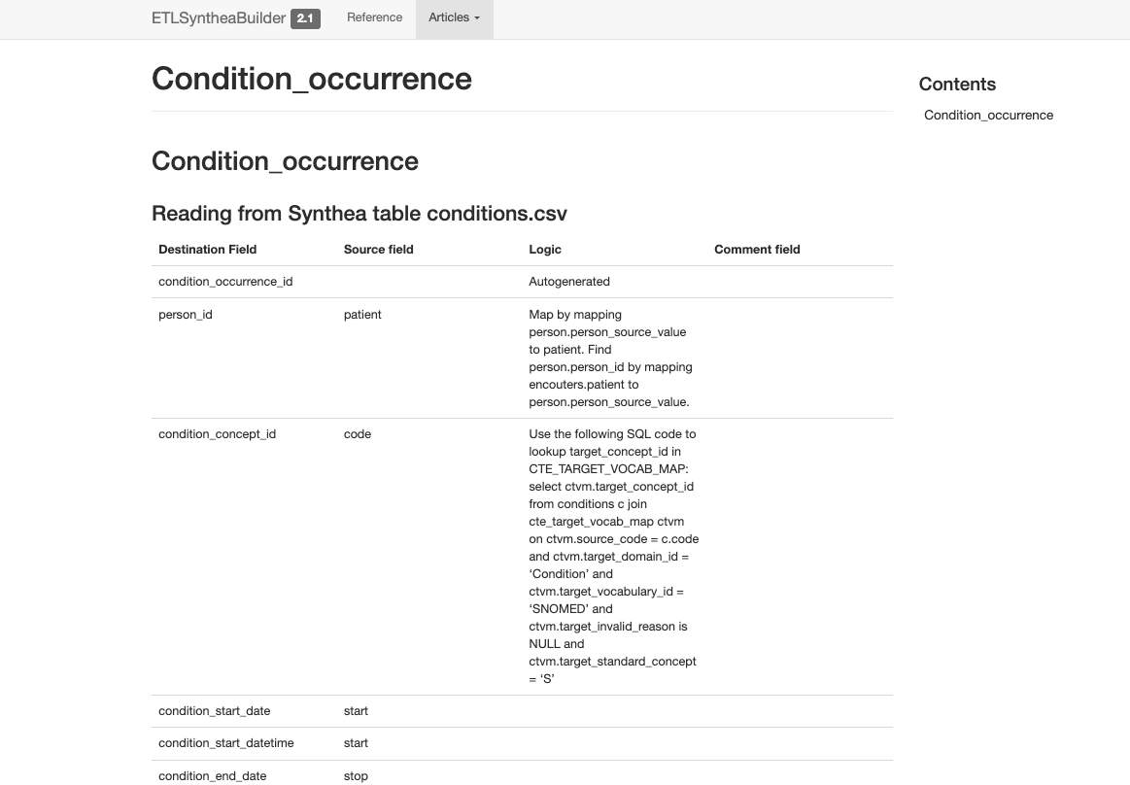
CONDITION_OCCURRENCE
Check the raw data to understand domain movement of codes.
Data in the native “conditions” table will go to the table based on the domain of the mapped standard concept
https://ohdsi.github.io/ETL-Synthea/articles/condition_occurrence.html

Slide 70
Synthea Tables
File | Description
allergies.csv | Patient allergy data.
careplans.csv | Patient care plan data, including goals.
claims.csv | Patient claim data.
claims_transactions.csv | Transactions per line item per claim
conditions.csv | Patient conditions or diagnoses.
devices.csv | Patient-affixed permanent and semi-permanent devices.
encounters.csv | Patient encounter data.
imaging_studies.csv | Patient imaging metadata.
immunizations.csv | Patient immunization data.
medications.csv | Patient medication data.
observations.csv | Patient observations including vital signs and lab reports.
organizations.csv | Provider organizations including hospitals.
patients.csv | Patient demographic data.
payer_transitions.csv | Payer Transition data (i.e. changes in health insurance).
payers.csv | Payer organization data.
procedures.csv | Patient procedure data including surgeries.
providers.csv | Clinicians that provide patient care.
supplies.csv | Supplies used in the provision of care.

Slide 71
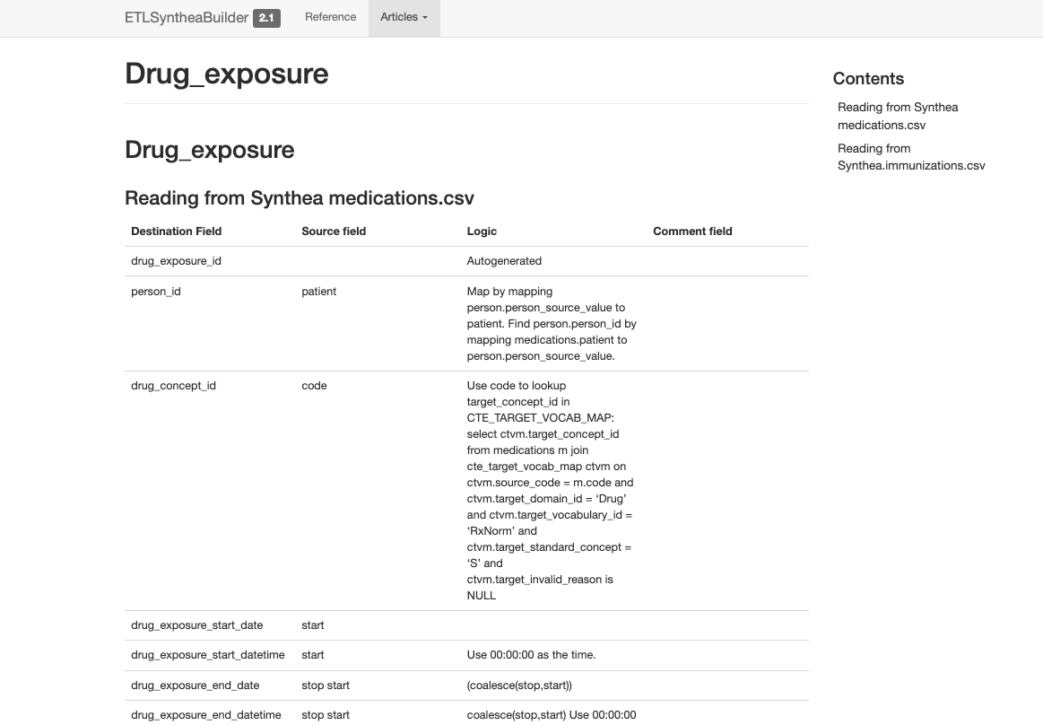
DRUG_EXPOSURE
Use type concepts to denote between ordered, administered, dispensed drugs
https://ohdsi.github.io/ETL-Synthea/articles/drug_exposure.html

Slide 72
Generating a CDM

Slide 73









ETL Implementation
General Flow of Implementation
A good rule of thumb is to always create the PERSON table first
The VISIT_OCCURRENCE table must be created before the standardized clinical data tables as they all refer to the VISIT_OCCURRENCE_ID
Additional clinical data tables…
Notes:
First question you might have is: I have my logic written how do I get started?
It is a good idea to create the dimensional tables (PROVIDER, LOCATION, CARE_SITE) at the same time as PERSON
Not only does it make sense because person_id and visit_occurrence_ids are foreign keys in each of the tables, you also are able to answer a lot of questions very quickly this way.
- Who is in my data set? What are their demographics? How long are they observed continuously in the data? What types of visit settings are they seen in most frequently?

Slide 74







ETL Implementation
Notes:
Your next question might be: Okay, I know the order I should get started in, what should I use?

Slide 75
ETL Implementation - Considerations
What is the size of my data?
How complex is my data?
What systems do I need access to?
Do I need to access multiple systems?
Are standard vocabularies represented in my data already?
Do I need to consult someone with clinical expertise?
How often do I need to refresh my CDM?
What tools do I have access to?
What tools do I need access to?
Notes:
And then you may have other questions!
In the example today we are going to demo a simple builder using SQL and R called ETL Synthea. You can use the general principle of etl synthea as a process on how to get started with your own ETL.

Slide 76
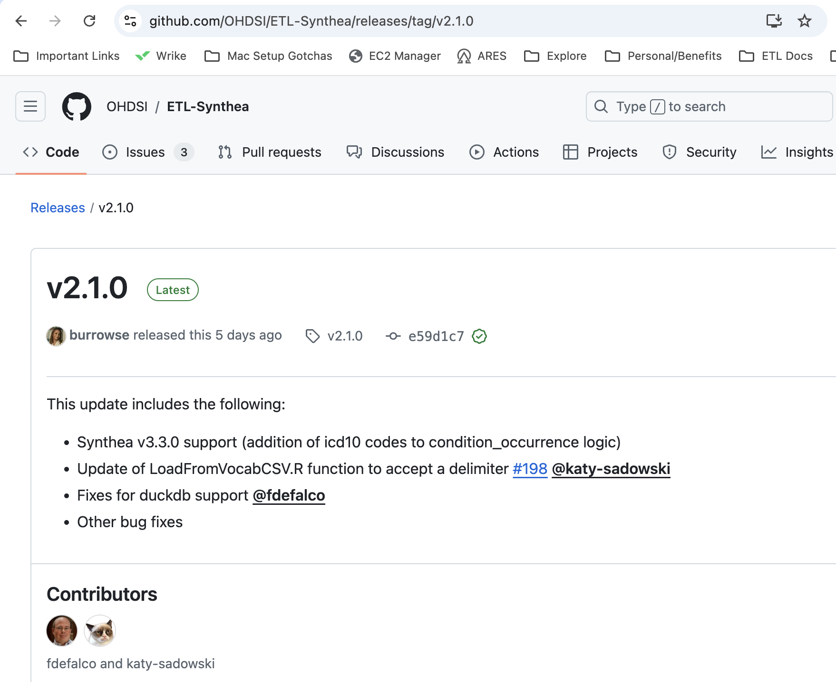
OHDSI/ETL-Synthea
R based ETL Tool
Converts Synthea > OMOP
Synthea v2.7 – v3.3
OMOP v5.3 and v5.4
OHDSI Databases Supported
https://github.com/OHDSI/ETL-Synthea/releases/tag/v2.1.0

Slide 77




What do I need to get started?
R & R STUDIO
OMOP VOCABULARY FILES
SYNTHEA DATA
YOUR DATABASE

Slide 78
Running ETL- Synthea
Download and install the package
Define your parameters and create your connection to your database
Create table shells for your Synthea data and OMOP CDM
Load your Synthea data files into the database
Load your Vocabulary data files into the database
Execute your ETL!

Slide 79
Give it a try!
https://github.com/OHDSI/ETL-Synthea/blob/main/README.md

Slide 80
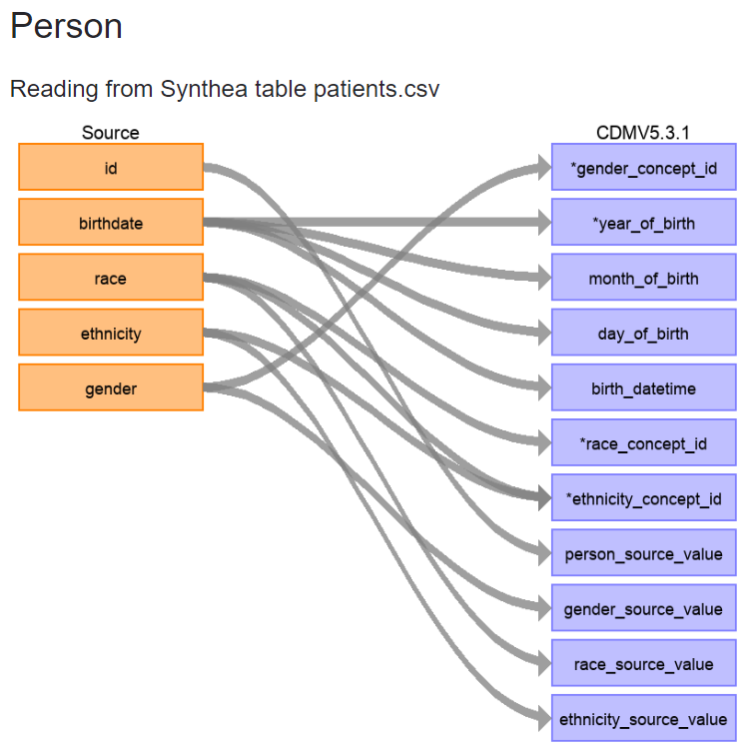
ETL Implementation
First, let us review the logic we decided on for how the PERSON table should be created.
Navigate in your browser to: https://ohdsi.github.io/ETL-Synthea/articles/person.html

Slide 81
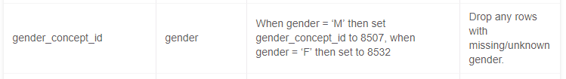
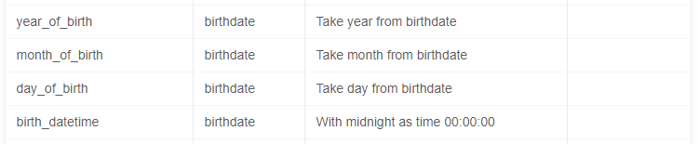
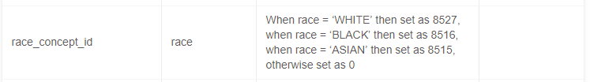
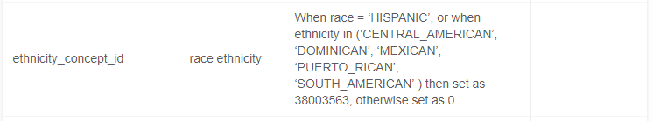
ETL Implementation
First, let’s review the logic we decided on for how the PERSON table should be created.
Gender:
Birthdate:
Race:
Ethnicity:

Slide 82
ETL Implementation
How should the PERSON table logic be implemented in SQL?
To open the query while we review:
https://github.com/OHDSI/Tutorial-ETL
Materials 🡪 Implementation🡪 Insert_Person_Lauren.sql
You can either view it directly in GitHub or download it and open it in pgAdmin4

Slide 83
Resources
The full Synthea builder can be found here:
https://github.com/OHDSI/ETL-Synthea
Another example of a R/SQL builder for a much larger database:
https://github.com/OHDSI/ETL-HealthVerityBuilder
A builder created using .NET:
https://github.com/OHDSI/ETL-CDMBuilder
A builder created using the AWS lambda functionality:
https://github.com/OHDSI/ETL-lambdabuilder
(in development)

Slide 84
Example Builder 1: Janssen CDM Builder Over Time
Simple SQL Queries
Simple SQL Queries + Cursors
SAS Builder
Simple
Data Experts & CDM Experts
C# Single Machine
C# Multiple Machine
C# in Cloud Enabled Environment
Sophisticated
Data Experts & CDM Experts
Technical Experts
https://github.com/OHDSI/ETL-CDMBuilder

Slide 85
Evaluating a CDM ETL & Data Quality

Slide 86

Evaluation Tools & Processes
Goal: Make sure an OMOP ETL functions as expected and produces a specification-compliant OMOP CDM.
SDLC best practices
ACHILLES
Unit tests
DataQualityDashboard
Notes:
Pull up achilles on the VM to explore

Slide 87
Unit Test Cases
Testing your CDM builder is important:
ETL often complex, increasing the danger of making mistakes that go unnoticed
CDM can update
Source data structure/contents can change over time
Rabbit-In-a-Hat can construct unit test, or small pieces of code that can automatically check single aspects of the ETL design

Slide 88
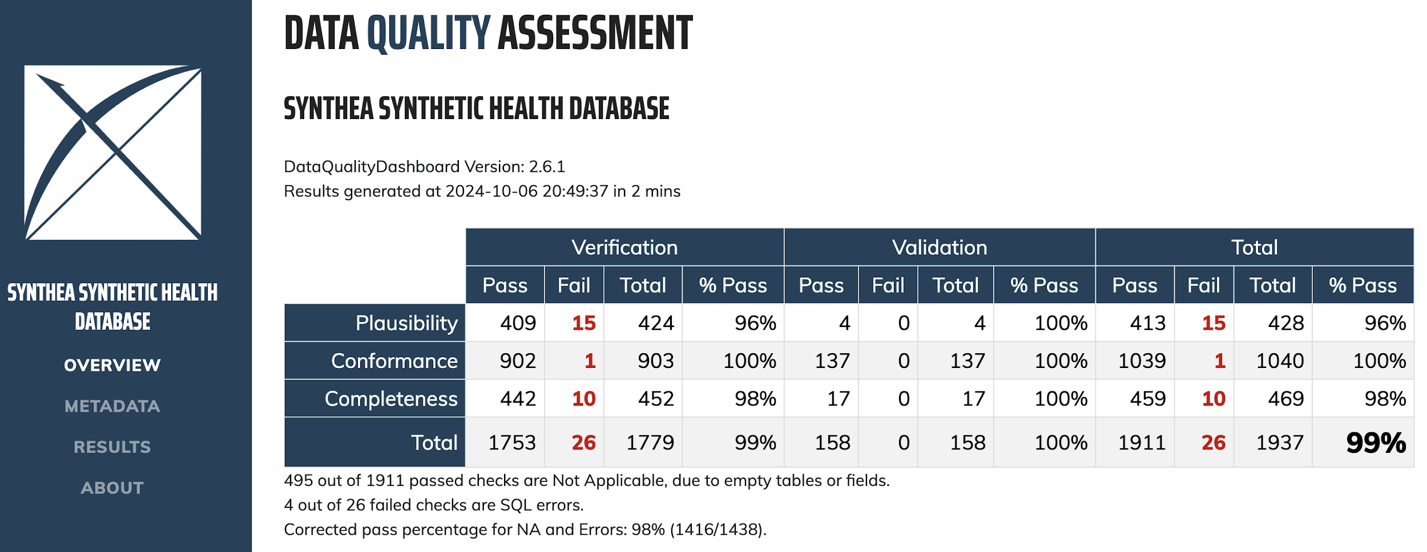
DataQualityDashboard
R package
https://github.com/OHDSI/DataQualityDashboard
Part of the HADES suite
26 data quality check types --> over 4,000 individual data quality checks
Results exported to json, csv, or database table, and can be explored in an R Shiny application

Slide 89
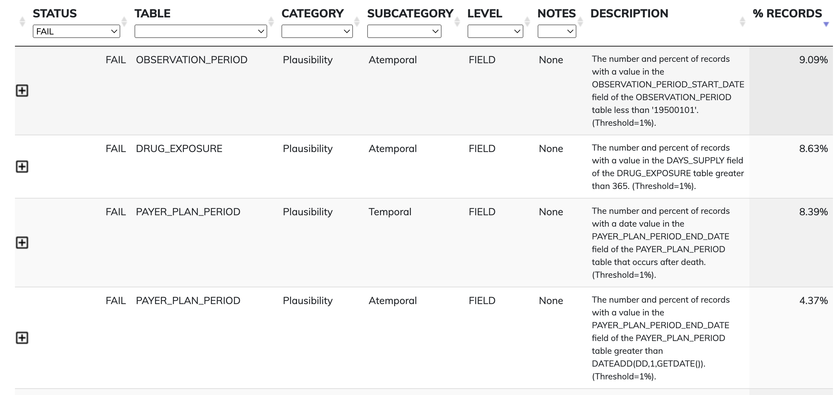
DataQualityDashboard

Slide 90
Data quality check definition
An aggregated summary statistic that can be computed against a dataset and to which a decision threshold can be applied to determine if the statistic meets expectations.
Blacketer, Clair and Williams, Andrew. 2019. Data Quality. https://www.ohdsi.org/wp-content/uploads/2019/09/2-Plenary-1-OMOP-DQ-Clair-Andrew.pdf

Slide 91
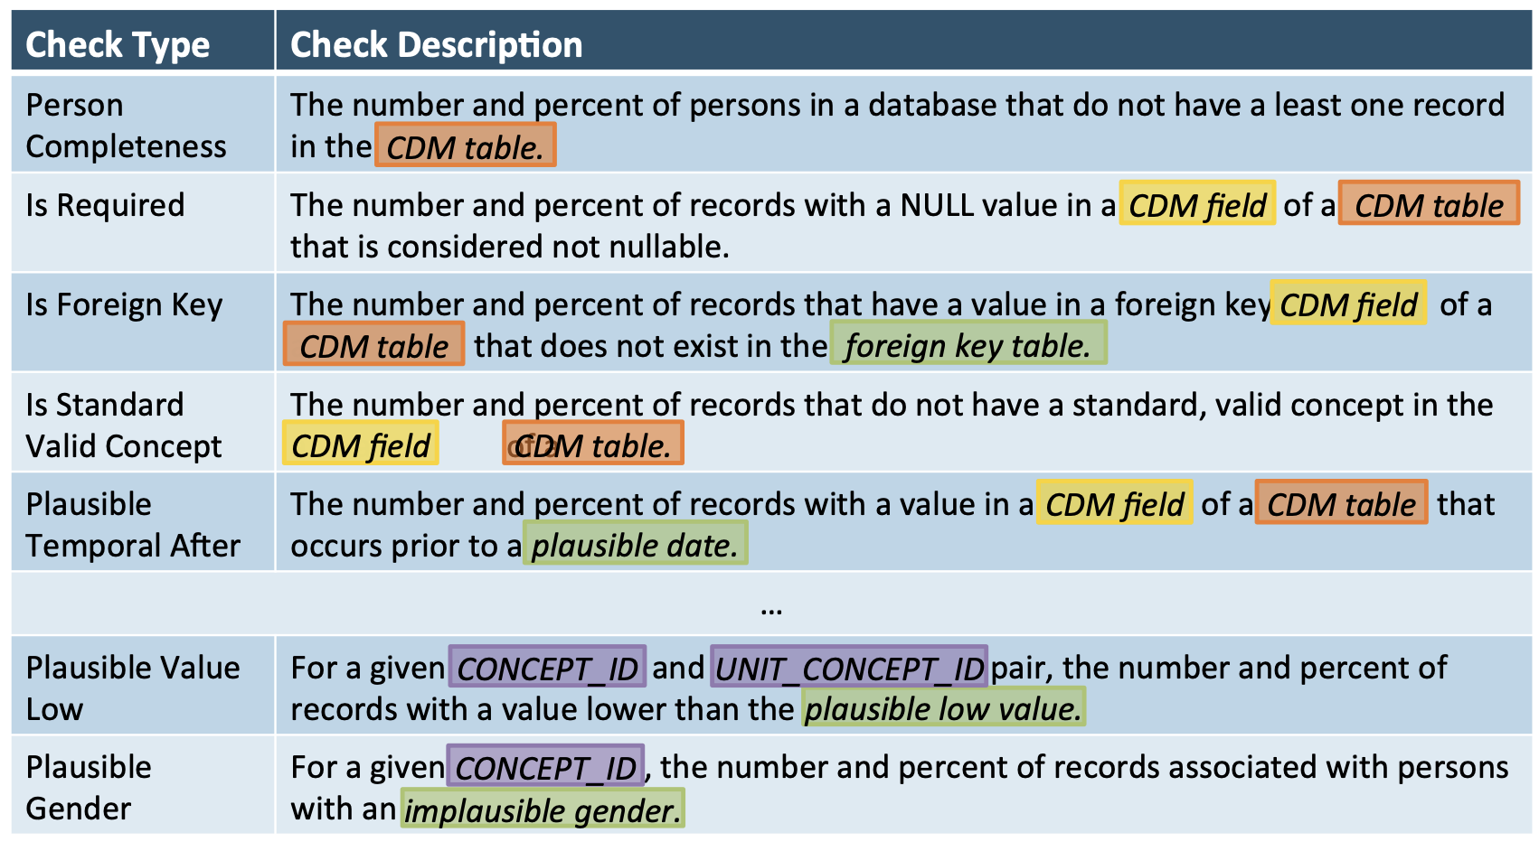
Data quality check types
Blacketer, Clair and Williams, Andrew. 2019. Data Quality. https://www.ohdsi.org/wp-content/uploads/2019/09/2-Plenary-1-OMOP-DQ-Clair-Andrew.pdf

Slide 92


Data quality check thresholds
An aggregated summary statistic that can be computed against a dataset and to which a decision threshold can be applied to determine if the statistic meets expectations.
DON'T ACT
ACT
0% of records failed the DQ check
THRESHOLD
100% of records failed the DQ check

Slide 93

Data quality check thresholds
Fatal checks: Threshold is always 0
CDM convention checks: Threshold should be 0 in theory, but may need to be adjusted in practice
Characterization checks: Threshold depends on expectations of the data source*
DON'T ACT
ACT
0% of records failed the DQ check
THRESHOLD
100% of records failed the DQ check
*and the analytic use case

Slide 94

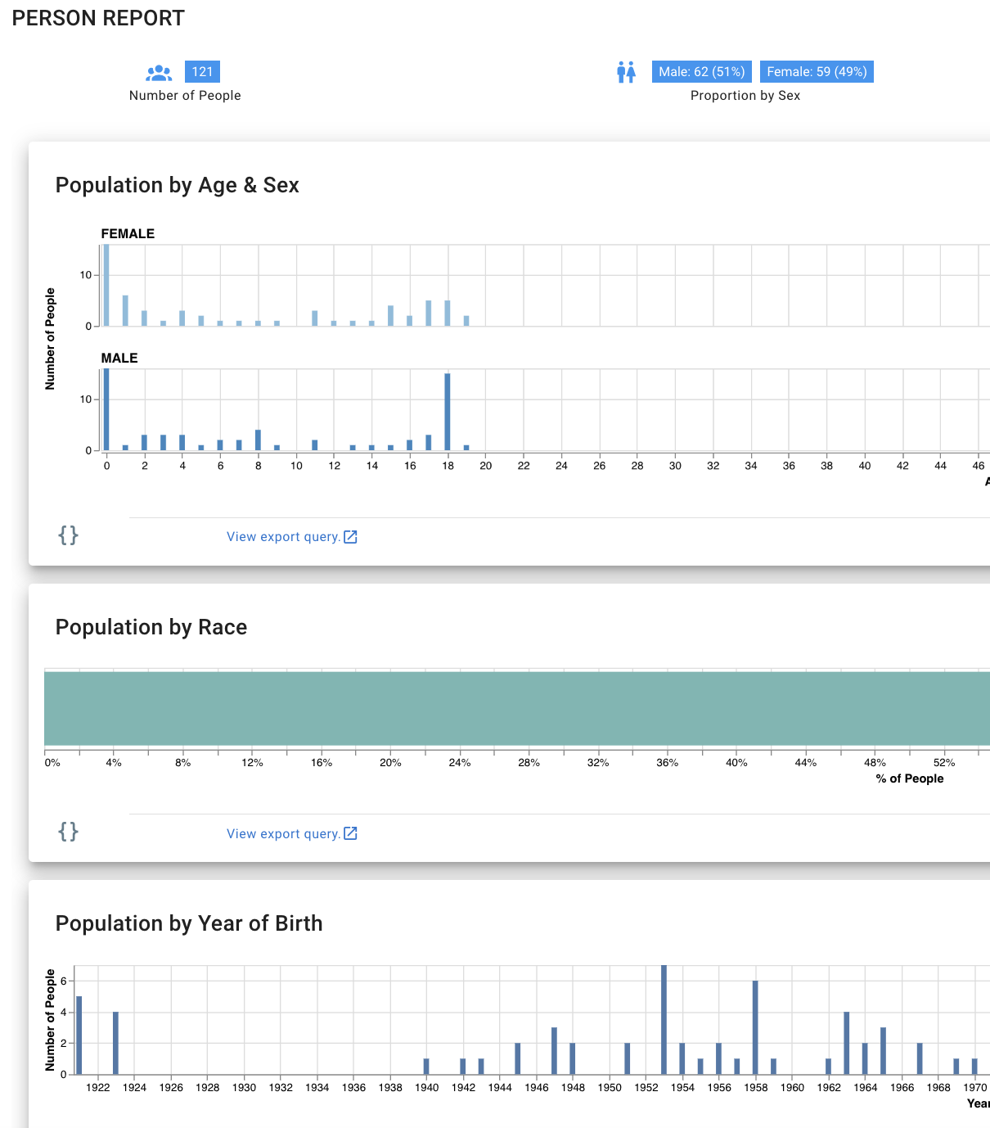
ACHILLES
R package
https://github.com/OHDSI/achilles
Part of the HADES suite
Provides descriptive statistics on an OMOP CDM
Results can be visualized in ARES or ATLAS

Slide 95


ETL Maintenance
ETL Documentation
Changed or Updated Raw Data?
ETL
Bug Found?
Updated CDM
New Vocab?
All are involved in quality control
A technical person implements the ETL
CDM Update?

Slide 96
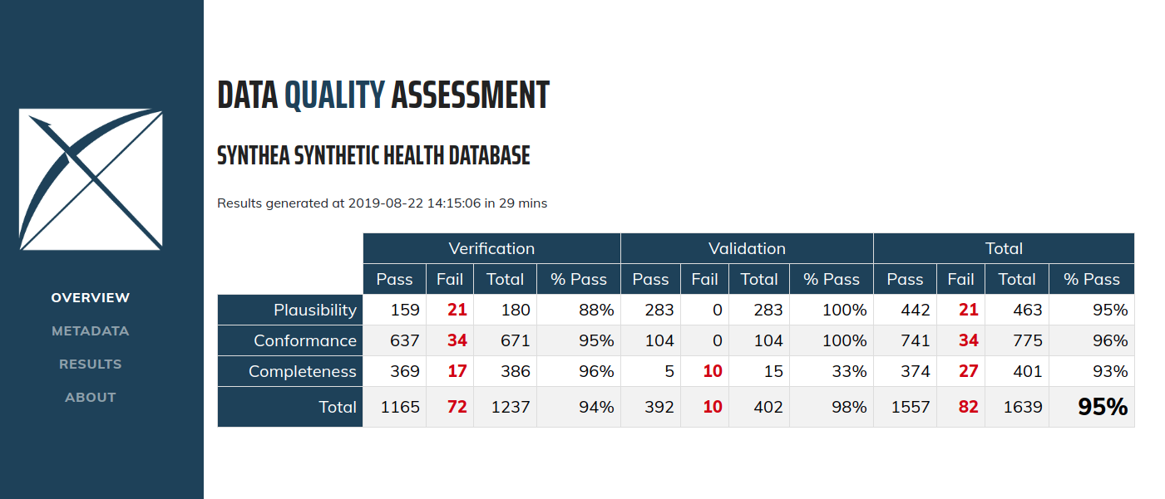
DataQualityDashboard (DQD)
Runs a prespecified set of data quality checks and thresholds on the CDM

Slide 97
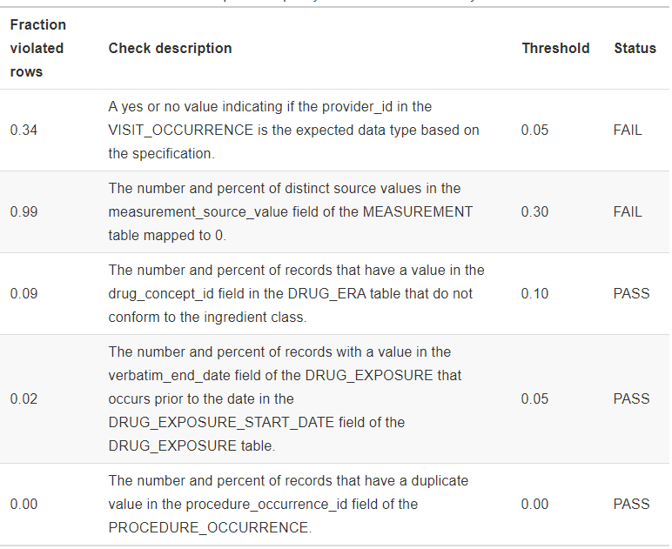
DQD Example Rules

Slide 98
Achilles
Achilles is a data characterization and quality tool available for download here:
https://github.com/OHDSI/Achilles
For an example of how it was run for our sample data, that R script is located here:
https://github.com/OHDSI/Tutorial-ETL/blob/master/materials/Achilles/achillesRun.R
Notes:
Pull up achilles on the VM to explore

Slide 99
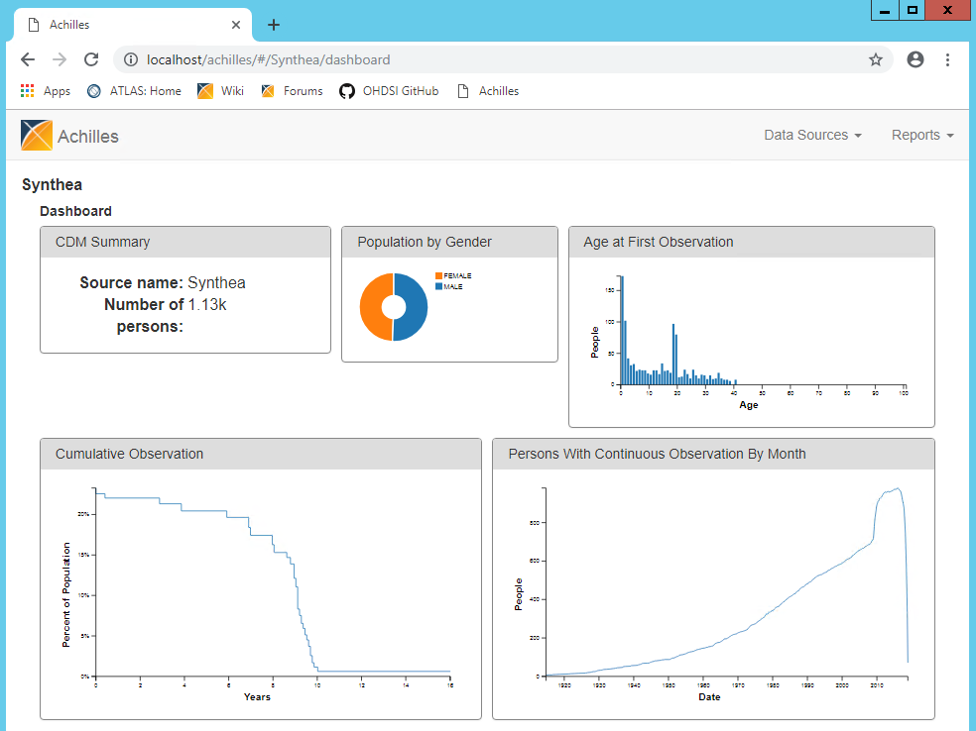
Achilles

Slide 100
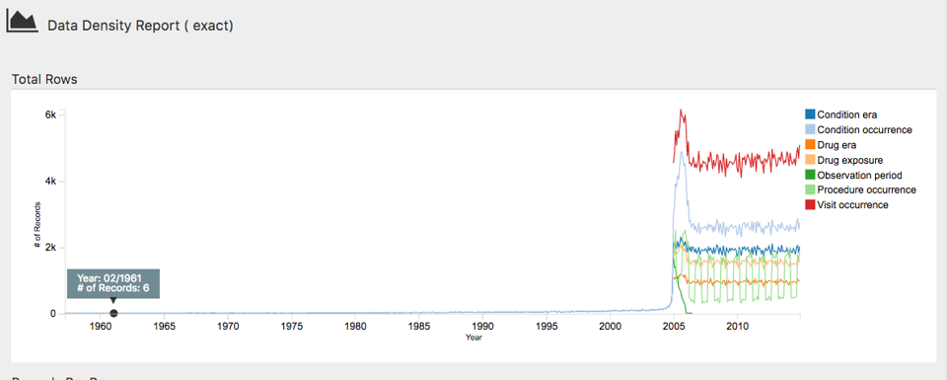
Achilles
This plot shows that the bulk of the data starts in 2005. However, there also appear to be a few records from around 1961, which is likely an error in the data.

Slide 101
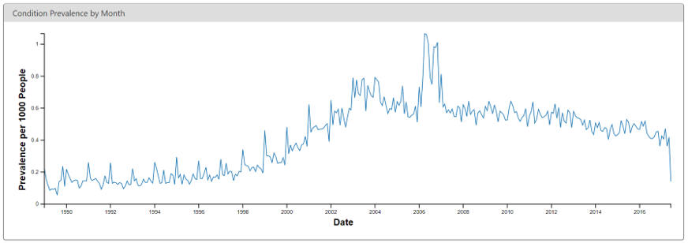
Achilles
This change coincides with changes in the reimbursement rules in this specific country, leading to more diagnoses but probably not a true increase in prevalence in the underlying population.

Slide 102
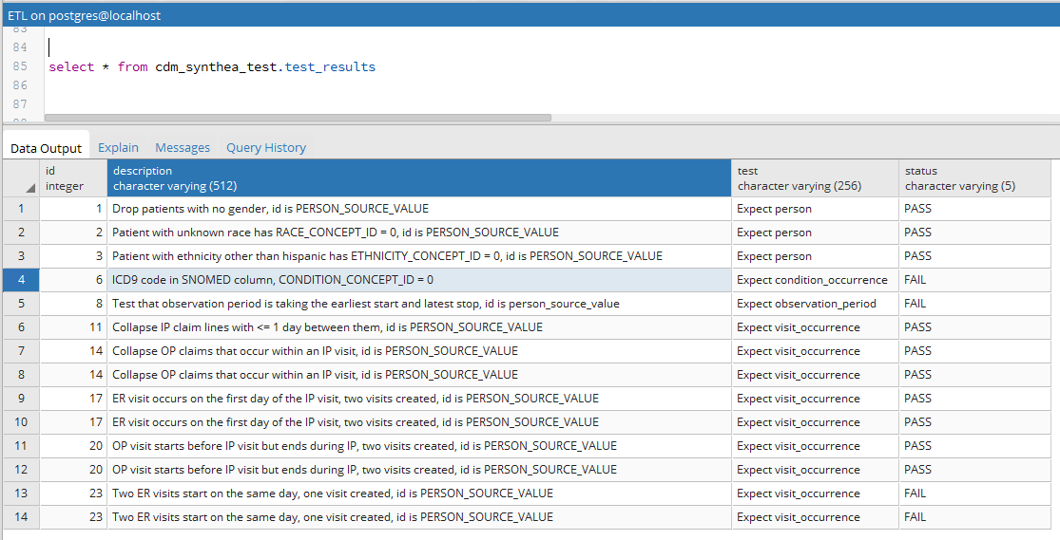
Issues in our synthetic data?
cdm_synthea
Did our test cases run?

Slide 103
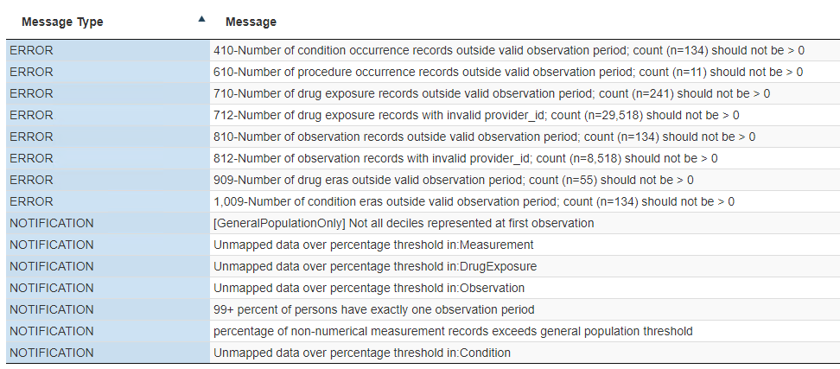
Issues in our synthetic data?
cdm_synthea
Did Achilles notice anything?

Slide 104
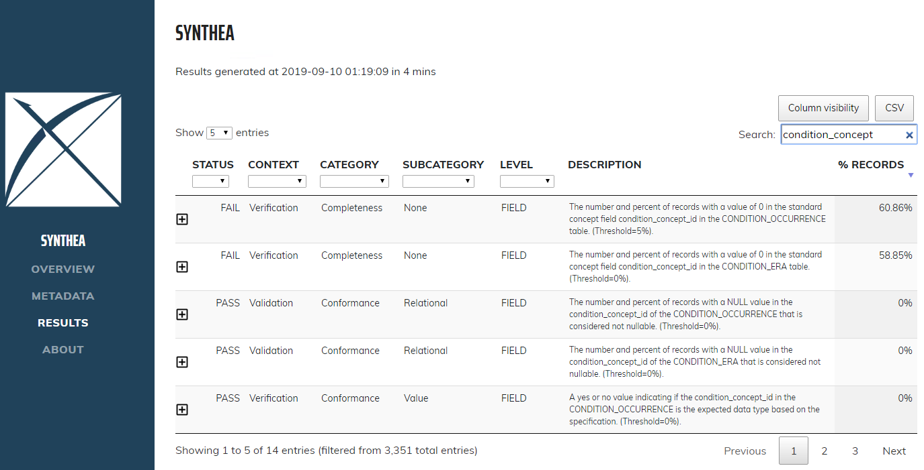
Issues in our synthetic data?
cdm_synthea
Did DQD notice anything?

Slide 105
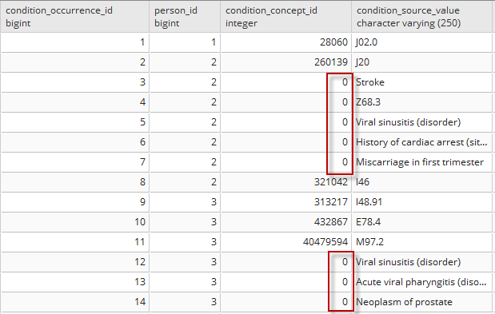
Maybe we have a bug?
In the CONDITION_OCCURRENCE, 61% rows are mapped to 0

Slide 106
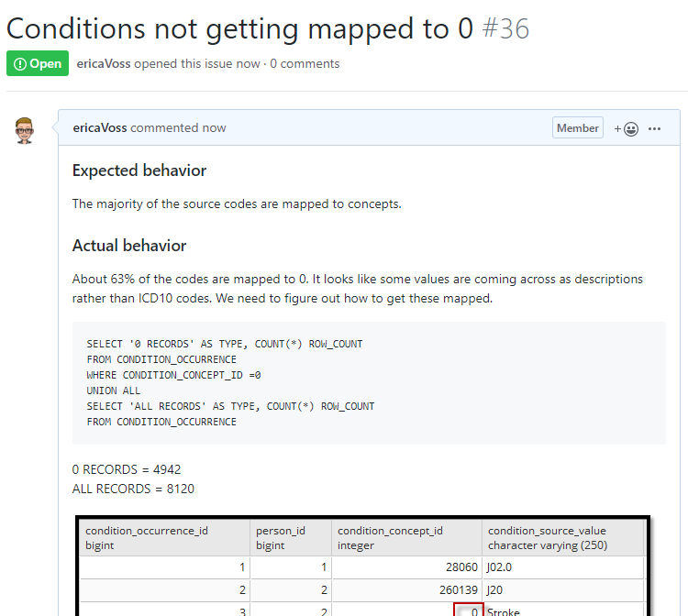
Document the Bug

Slide 107
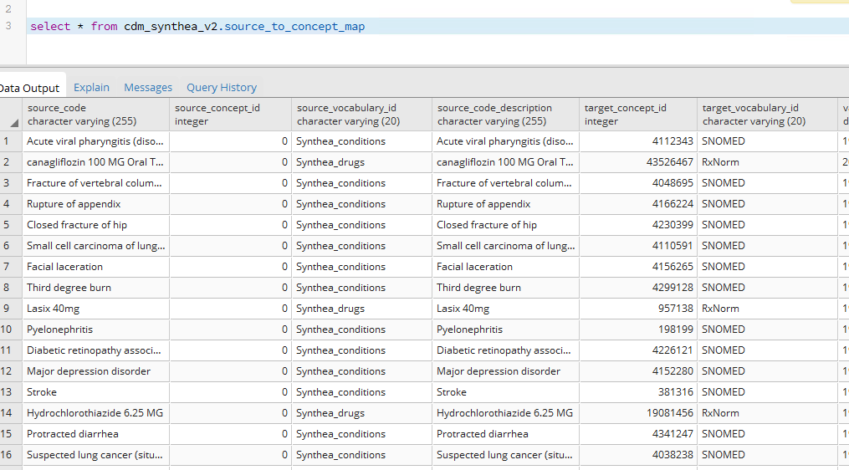
Vocabulary to fix the problem

Slide 108
Vocabulary to fix the problem
WITH CTE_VOCAB_MAP AS (
SELECT c.concept_code AS SOURCE_CODE, c.concept_id AS SOURCE_CONCEPT_ID, c.concept_name AS SOURCE_CODE_DESCRIPTION,
c.vocabulary_id AS SOURCE_VOCABULARY_ID, c.domain_id AS SOURCE_DOMAIN_ID, c.CONCEPT_CLASS_ID AS SOURCE_CONCEPT_CLASS_ID,
c.VALID_START_DATE AS SOURCE_VALID_START_DATE, c.VALID_END_DATE AS SOURCE_VALID_END_DATE, c.INVALID_REASON AS SOURCE_INVALID_REASON, c1.concept_id AS TARGET_CONCEPT_ID, c1.concept_name AS TARGET_CONCEPT_NAME, c1.VOCABULARY_ID AS TARGET_VOCABUALRY_ID,
c1.domain_id AS TARGET_DOMAIN_ID, c1.concept_class_id AS TARGET_CONCEPT_CLASS_ID, c1.INVALID_REASON AS TARGET_INVALID_REASON, c1.standard_concept AS TARGET_STANDARD_CONCEPT
FROM CONCEPT C
JOIN CONCEPT_RELATIONSHIP CR
ON C.CONCEPT_ID = CR.CONCEPT_ID_1
AND CR.invalid_reason IS NULL
AND cr.relationship_id = 'Maps to'
JOIN CONCEPT C1
ON CR.CONCEPT_ID_2 = C1.CONCEPT_ID
AND C1.INVALID_REASON IS NULL
UNION
SELECT source_code, SOURCE_CONCEPT_ID, SOURCE_CODE_DESCRIPTION, source_vocabulary_id, c1.domain_id AS SOURCE_DOMAIN_ID, c2.CONCEPT_CLASS_ID AS SOURCE_CONCEPT_CLASS_ID,c1.VALID_START_DATE AS SOURCE_VALID_START_DATE,
c1.VALID_END_DATE AS SOURCE_VALID_END_DATE, stcm.INVALID_REASON AS SOURCE_INVALID_REASON,target_concept_id,
c2.CONCEPT_NAME AS TARGET_CONCEPT_NAME, target_vocabulary_id, c2.domain_id AS TARGET_DOMAIN_ID,
c2.concept_class_id AS TARGET_CONCEPT_CLASS_ID, c2.INVALID_REASON AS TARGET_INVALID_REASON,
c2.standard_concept AS TARGET_STANDARD_CONCEPT
FROM source_to_concept_map stcm
LEFT OUTER JOIN CONCEPT c1
ON c1.concept_id = stcm.source_concept_id
LEFT OUTER JOIN CONCEPT c2
ON c2.CONCEPT_ID = stcm.target_concept_id
WHERE stcm.INVALID_REASON IS NULL
)
SELECT TARGET_CONCEPT_ID, TARGET_CONCEPT_NAME, TARGET_DOMAIN_ID
FROM CTE_VOCAB_MAP
WHERE SOURCE_VOCABULARY_ID = ‘Synthea_conditions'
Look in the Source to Concept Map table for a map

Slide 109
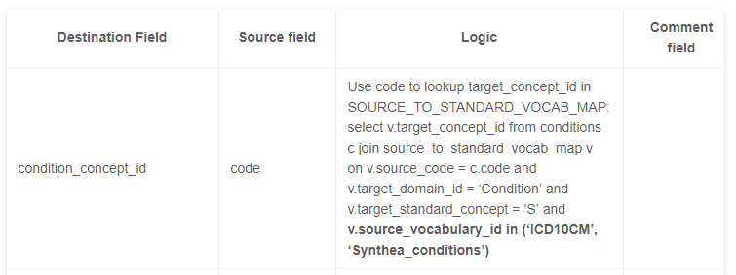
Update the ETL document
https://ohdsi.github.io/Tutorial-ETL/docs/cdm_synthea_v2

Slide 110
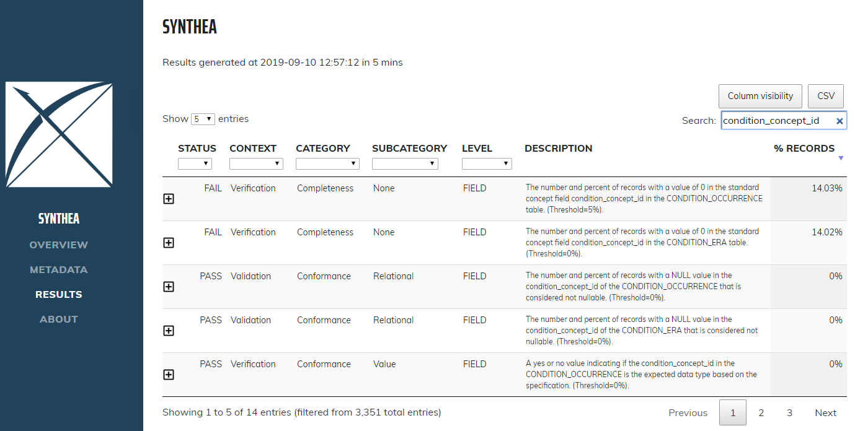
Re-run the DQD
TBD

Slide 111
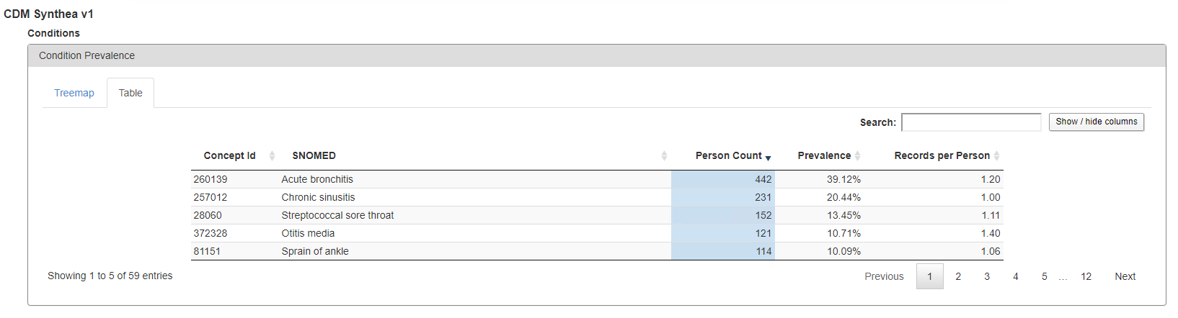

Re-run Achilles

Slide 112

Final Hard Lessons Learned

Slide 113
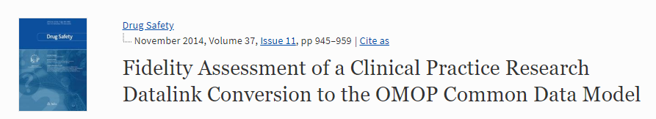

80/20 Rule
You don’t need to map all terms to get good data coverage!

Slide 114
Comfort with Data Loss
If there is data that is not of research quality or there are methods to adjust, use the ETL to standardize that
Example Patient Drop Counts from a CDM Build
Reason to Drop Someone | Person Count
Unknown gender | 23,592
Implausible year of birth - past | 749
Implausible year of birth - post earliest observation period | 3,836
Gender changes | 2

Slide 115
ETL Process
ETL Documentation
ETL
Data experts and CDM experts together design the ETL
People with medical knowledge create the code mappings
All are involved in quality control
A technical person implements the ETL
OHDSI Tools
White
Rabbit
Rabbit In a Hat
Usagi
White
Rabbit
ACHILLES
DQD
Rabbit In a Hat

Slide 116
ETL Maintenance
ETL Documentation
Changed or Updated Raw Data?
ETL
Bug Found?
Updated CDM
New Vocab?
All are involved in quality control
A technical person implements the ETL
CDM Update?

